Slide 1
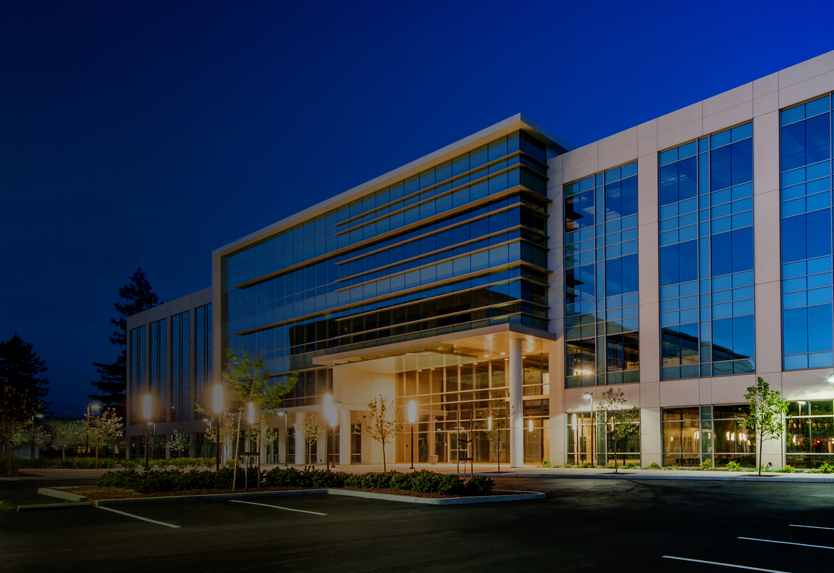
Honeywell remote building manager –
UPDATE/NEWS = Version 1.2
VACLAV MATZ
&
THOMAS GUENTER

Slide 2
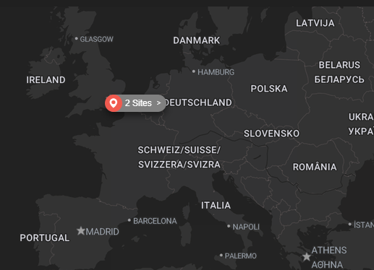
SUCCESS Across Europe !!!
UK
Poland
Germany
Denmark
Spain
Italy

Slide 3
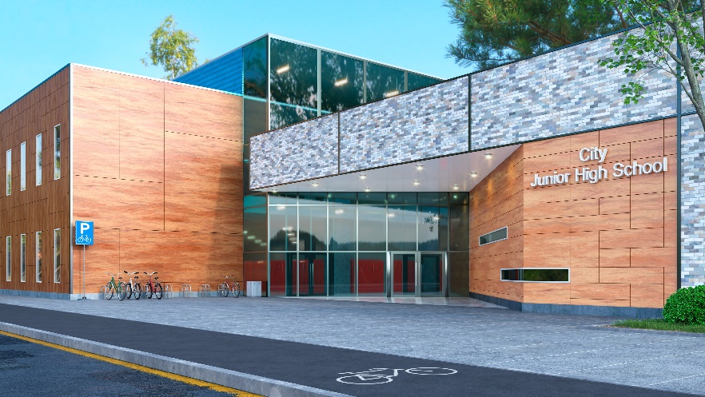




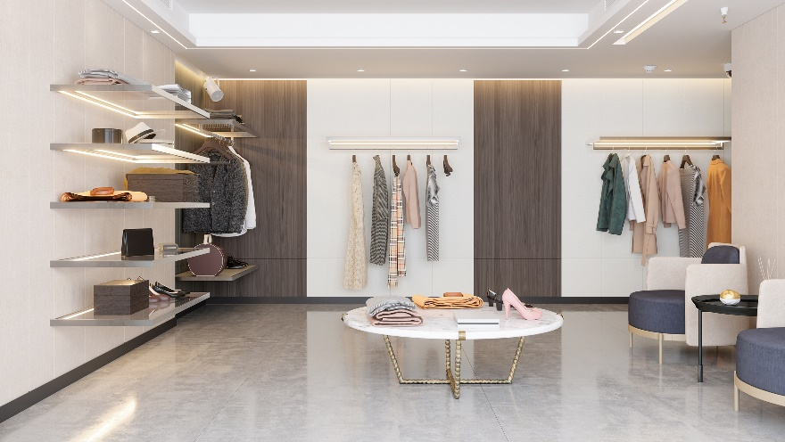
HONEYWELL REMOTE BUILDING MANAGER
verticals
Schools/Education
Healthcare
Financial
Government
Offices
Retail

Slide 4

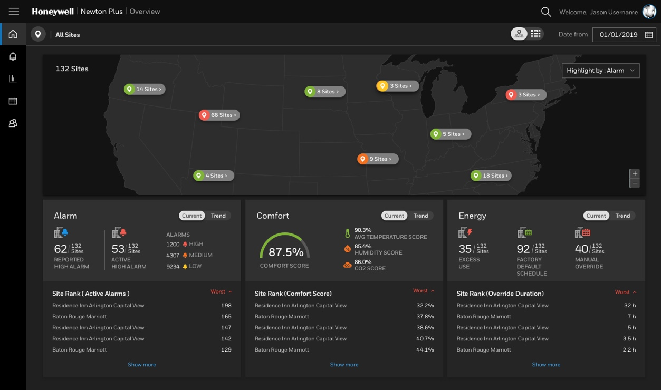

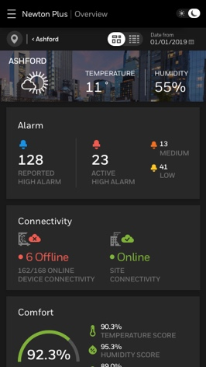
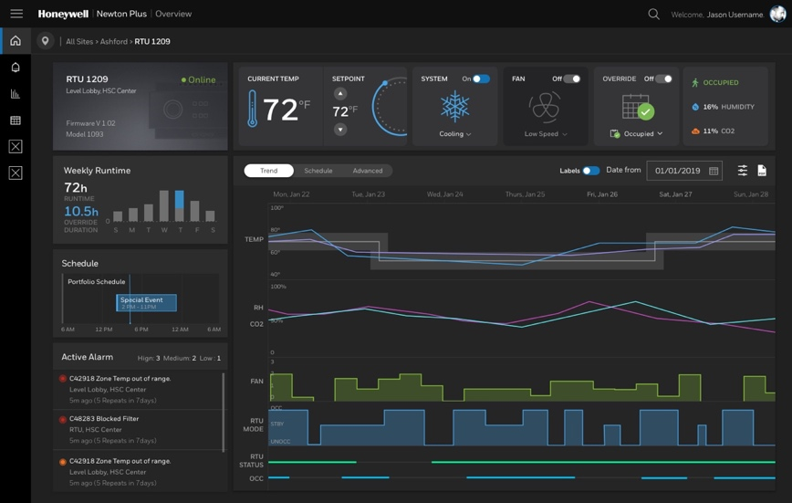



REMOTE BUILDING MANAGER
NEXT STEP iN DIGITALIZATION !!!
REMOTE MONITORING & CONTROL
Monitoring and control with convenience and consistency for sites from 50 to 5000 points connected via our secure gateway
INTUITIVE DASHBOARDS
Visualize real-time details as well as trends about comfort, energy, alarms, and KPIs
Points, schedules, Alarms
Quickly view and edit schedules, alarms, and setpoints by list, site, zone, or equipment level.
An entire ECOSYSTEM OF CAPABILITIES
Add advanced services as and when needed, such as AI-driven optimization for air quality, carbon, and energy management systems or space utilization.
End User
SECURE GATEWAY
On-Prem supervisor or HAWK/TONN/IQX
Service Provider
Honeywell
Partners
Notes:
Remote Building Manager is our newest cloud based supervisor which allows users to monitor and control their BMS via a simplified dashboards
Users can access Points list and make changes to setpoints, access alarms and schedules which are all necessary for efficient operation of the system.
Remote Building manager is not just a supervisor – it is designed to be more like an ecosystem of connected services.
Connected applications like Healthy Buildings dashboards, Honeywell Building Sustainability Manager can be easily added to the remote building manager subscription and does not require additional engineering tasks. Making it easier for customers to achieve their strategic goals like sustainability and employee wellbeing.

Slide 5
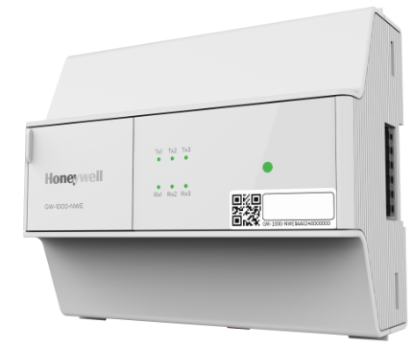
MAIN UPDATE = RBM&RBM Express = ver 1.2
Small and Medium Business Administrator is now a part of Remote Building Manager as the Express Tier. This combines what was previously two separate solutions into one cloud supervisor solution with a common portfolio dashboard which includes both Remote Building Manager and legacy Small and Medium Business Administrator sites.
NiagAra gateway = Supervisor, TONN, HAWK, IQX
GW-1000
HONEYWELL REMOTE BUILDING MANAGER
EXPRESS (FORMER SAMBA)
HONEYWELL REMOTE BUILDING MANAGER

Slide 6
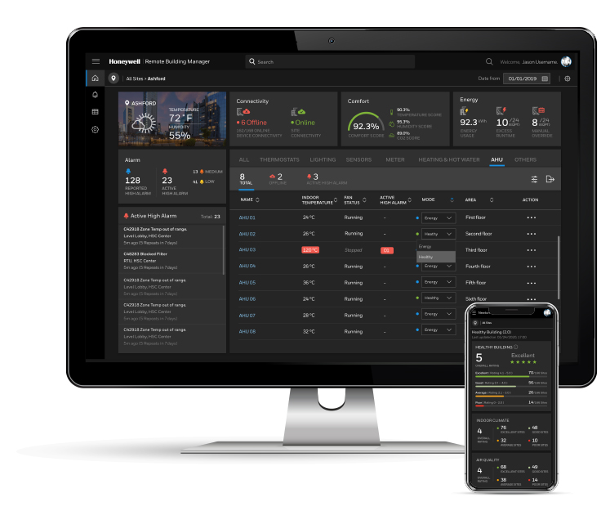
HONEYWELL REMOTE BUILDING MANAGER EXPRESS TIER
Main ingredients
Honeywell GW-1000
Central point for aggregating site data from
Plant controllers
Connected to controllers via WiFi
Secure communication to and from the site
location
Data securely routed across the internet to the cloud
Honeywell SMART IO
Honeywell IO module supporting to field sensors/ devices
Modbus meters and VRF supported via the onboarding wizard
Used to operate Sensor monitoring and ON/OFF of equipment such as Lighting
SUPERVISOR
Cloud-based Web UI available on Desktop, Laptop, Mobile
Multi-language Management Platform
Points list view, alarms, energy consumption and schedules
Long term storage and visualization of all values in combined Trend graphs

Slide 7
HONEYWELL REMOTE BUILDING MANAGER
Main ingredients – What’s new!!!
Easier to Purchase: Remote Building Manager is now available to order via the MyBuildings e-commerce portal. Personalization: Now you can upload a company logo to the Remote Building Manager dashboard. You can also add an image of each site on the site dashboard. Admin Portal Improvements: Makes administration and future changes to the tool easy to manage. Technical training module: Now available on My Honeywell Buildings University
HONEYWELL REMOTE BUILDING MANAGER

Slide 8

RBM TRAINING
 | Course Link | Course Details
MyHBU | Remote Building Manager - Technical Course | Course ID : 2514 Course Name : Remote Building Manager - Technical Course
Learning Hub | Remote Building Manager - Technical Course | Course ID : HBT_HBST_REMOTE_BUILD_MAN_TECH Course Title : Remote Building Manager - Technical Course

Slide 9
Ordering information
SUBSCRIPTION | SKU | DESCRIPTION
RBM Express | SAMBA-SW-BASIC | Basic supports up to 24 WiFi devices (Thermostat and Smart IO)
Express | SAMBA-SW-ENHA | Enhanced = Basic + supports up to 100 LoRaWan Sensors
Express | SAMBA-SW-ENHA-HB1 | Enhanced + Healthy Building - 1 Monitored Zone (Supports 3 LoRaWAN Sensors)
Express | SAMBA-SW-ENHA-HB3 | Enhanced + Healthy Building - 3 Monitored Zones (Supports 9 LoRaWAN Sensors)
Express | SAMBA-SW-ENHA-HB6 | Enhanced + Healthy Building - 6 Monitored Zones (Supports 18 LoRaWAN Sensors)
Express | SAMBA-SW-ENHA-HB9 | Enhanced + Healthy Building - 9 Monitored Zones (Supports 27 LoRaWAN Sensors)
RBM Base | RBM1000x | RBM Base - 50 pts annual fee
RBM Intermediate | RBM2005x | RBM Intermediate - 500 pts annual fee
Intermediate | RBM2012x | RBM Intermediate - 1250 pts annual fee
Intermediate | RBM2025x | RBM Intermediate - 2500 pts annual fee
RBM Advanced | RBM3050x | RBM Advanced 1x N4 Supervisor /5000 pts annual fee
ADD-ON | RBMU001 | Add 50 points (can be done in bulk)
ADD-ON | RBMU051 | Enable Advanced Schedule (Needed only for RBM1000)
ADD-ON | RBMU052 | Enable Healthy Building Dashboard
PART NUMBER KEY
Brand | Add Letter to End of Part Number
Alerton | A
HON EU | C
SBC | C
Trend | T
HON NA | H
Example: The part number for RBM1000 for HON NA is RBM1000H.

Slide 10


Honeywell CLOUD OFFERINGs OVERVIEW
Occupant
Experience
???
Predictive Maintenance
???
Energy Optimization
Honeywell Building Sustainability Manager
Carbon and Energy Management (Monitor)
Carbon and Energy Management (Control)
Cloud
Supervisor
Remote Building Manager
Small and Medium Building Administrator
RBM Gateway
BMS Supervisors based on Niagara
On-Prem
Supervisor
Small and Medium Building Administrator Hardware
BMS Programmable controllers
Hardware
Low
Building complexity
High
Buildable offering customized to your building's needs

Slide 11
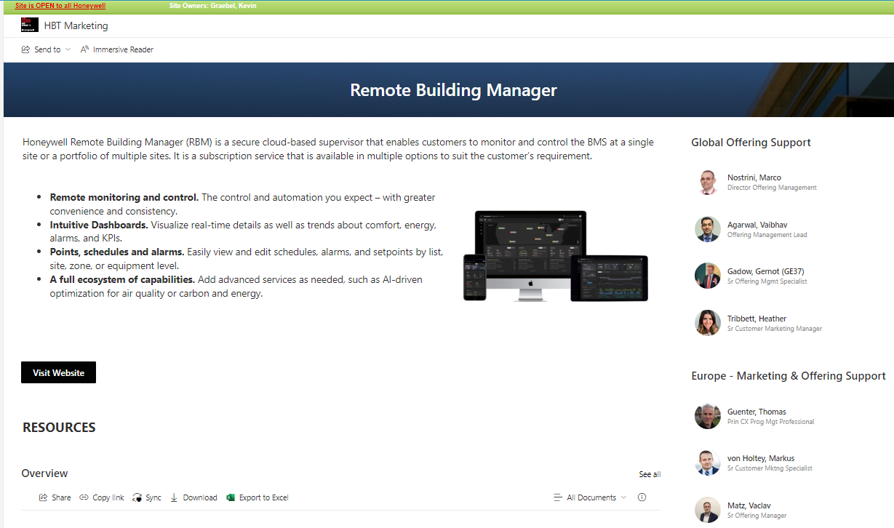
SHAREPOINT

Slide 12
Go to market – RBM Launch Plan
Timeline | Actions | Who | Status
Mar 23’ | Campaign #4 – LinkedIn post – RBM vertical positioning | CM/OM | DONE
TODAY | RBM Re-Launch | Sales | DONE
Aug/Sep 23’ | On-line demo regional sales training – How to DEMO RBM | OM/Sales | In Progress
Sep 23’ | Case Studies – references | CM/OM | In Progress
OCT 23’ | RBM & Add ons = CEM | OM | In Progress

