Slide 1


System Integrator and Service provider
Done – No work required
COST TO SERVE
DIFFERENTIATION
The value derived from implementing any new software service must surpass its associated cost to serve. It is imperative that these services yield a positive return on investment (ROI) to justify their adoption.
I need to differentiate my service to retain and win new customers and position my business against the cost savings initiatives for ‘standard’ work.
priorities
For system integrators and service providers, digital services are transforming business operations. The key opportunities and challenges include:
Growing service and project business
Increasing margins
Delivering maximum value to customers
Winning and retaining customers
Solve for digital workforce needs and price sensitivity in new markets
AVAILABILITY OF SKILLED LABOUR
INCREMENTAL GROWTH
I must adapt my business model to the current job market, enable my workforce with AI driven digital tools, generate capacity to manage 2x contracts
I would like to offer additional services, expand my business and shorten sales acquisition times.

Slide 2
FORGE STRATEGY| Data – INSIGHTS - APPLICATIONS
Include
Increase productivity, digitize services
Remote Commissioning App
Remote Building Manager (Supervisor) App
Insight and Report Builder App
Opportunity Assessment App
Obsolescence Assessment App
Predictive Maintenance (PDM)
Portfolio Manager App
* Apps are designed but not limited to the use for service providers
Seamlessly cyber secure connection
No reprogramming in the field
1 day on-boarding
Frictionless Onboarding
Service Provider Apps
HONEYWELL
FORGE
100% self serve on-boarding
Automated data contextualization
100% self serve user and subscription management
Cockpit view
Reduce Energy, reduce risk, increase uptime
Carbon and Energy Management, Sustainability monitoring
CEM, power manager
Building KPI views
Cyber vulnerability tracking
Predictive Maintenance (PDM) - Asset reliability as a service
End Customer Apps
100% Self-Service

Slide 3

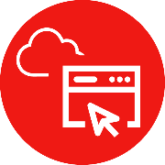

HOLISTIC APPROACH
v
Done no work required
CONNECTING TO THE OUTCOMES THAT MATTER MOST
Simplified Connectivity, Faster Time To Value
Native connectivity design as default in Honeywell and Tridium products and software to streamline connectivity from days to hours for faster time to insight and value.
Digital Services & Customer Portal
Digitally empowered service professionals, smart tools, software applications and more for an insights-led approach to asset lifecycle management, uptime, compliance and better building performance.
Choice of Software Applications & Managed Services
New tiering of packaged software applications, managed services and API services connecting your people to the insights, automation and control that help you achieve the outcomes that matter most – risk mitigation, energy efficiency, operational efficiency and more.

Slide 4







FORGE PLATFORM
Convert to Infographic – to discuss with Ashley for guidance
TECHNICAL ARCHITECTURE ENABLING BA CONNECTED STRATEGY
Customer Apps
Remote Building Manager (Supervisor), Opportunity Assessment, Obsolescence Assessment
Insight & KPI Report
(Insight Builder)
Predictive Maintenance (PDM)
Honeywell Building Operation Centre
(Managed Services)
Energy Mgmt (CEM)
Partner / HBOC Apps
Applications
Asset Reliability Mgr.
Remote
(Commissioning App)
Portfolio Mgmt. App
Management Portal
Partner Portal
(Subscription Management | User & Org Management | Onboarding | Remote Device Management)
API Management Portal *
(Forge APIs | Integration Libraries | Low Code - No code)
BA Ecommerce/ CPQ
Partner Portal
Forge Connectivity Layer
Forge IoT
Forge Remote
Remote Device Management
(bidirectional IoT communications)
(for remoting to gateway, Supervisor, controllers, IoT Devices)
(for remoting to devices)
Data
Remote
OTA
CLOUD
ON-PREMISE
Gateway
Honeywell Forge Gateway
Honeywell Forge Niagara Connect
Cloud Connector
Niagara Cloud Link
Connectivity
Supervisor
EBI
Common Supervisor (BMS Channel)
Alerton Compass
Niagara (Tridium)
EBI Cloud Connector
Niagara Cloud Link
Compass Cloud Connector
Niagara Cloud Link
Plant Controllers
Optimizer
JACE
IQ5
Cloud Connector
Niagara Cloud Link
IQ5 Cloud Connector
IoT Devices
TC 300
TC 500
CPWR HUB
Cloud Connector
Cloud Connector
Cloud Connector
48,334( BA-1775 |HCB-24275 | HCE -22282)
4

Slide 5

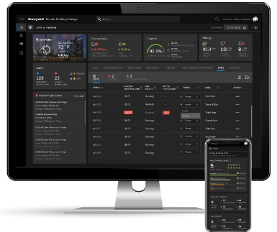
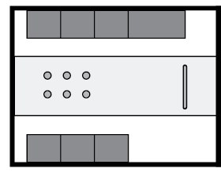
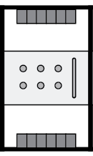
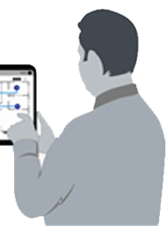


SELF SERVICE journey
Include
5
Service Provider
4
Subscription activated
3
Complete gateway commissioning tasks using the onboarding wizard
2
Channel partner/ SI logs in to Admin portal
Create site & users and attach to available subscription
1
Order processed
SKU visible as available subscription on Admin portal within 72 hrs
Order SKUs on HBT ecommerce portal (Titan) * (coming soon)
Order acknowledgement received
SELF SERVICE CUSTOMER JOURNEY
Notes:
What you see on the screen is an illustration on how easy it is for customers to transact and onboard remote building manager.
All starts with customer placing order for the subscription of remote building manager. While customers can place orders the traditional way, they can also use the HBT ecommerce platform to select the part codes and place the order. Once the order is processed customers get an email confirmation.
As mentioned before the self service admin portal allows our channel partners to create sites and manage subscriptions and users. Once they log in to the admin portal they can see the remote building manager subscription they have purchased which is available to be attached to new sites. They can then go ahead and create the site and attach the relevant subscription to it.
I now want to show you a how the gateway is commissioned using the onboarding wizard.
What you get at the end is the access to the remote building manager application.
I will now give you quick demonstration of the remote building manager application.

Slide 6
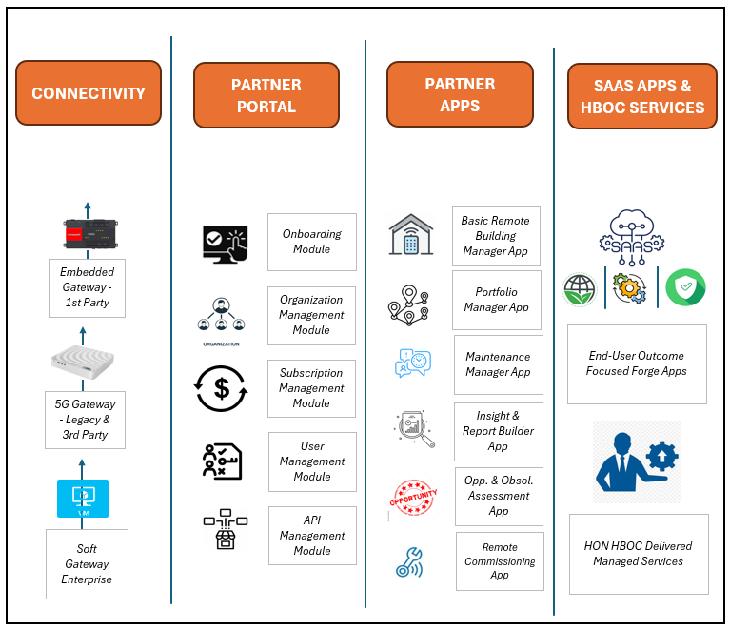
BA connected platform: PRODUCT EXECUTION STRATEGY
One platform from BA built on Forge 2.0
1
Channel install base monetization through remote management & partner portal
2
PdM
End user monetization with value added applications and after market services
3

Slide 7
How ArE We DOING IT
Slide 4 does cover all
1
FASTER & FLEXIBLE ordering
2
STREAMLINED CONNECTIVITY
3
SELF SERVICE PARTNER PORTAL
4
SPECIALIZED APPS
Mybuildings.honeywell.com for instant ordering
Order Hardware & SW subscription SKUs together
One cloud connection pipe - multiple form factors
Remote management
More than just telemetry & alarms
Full Self-Service capabilities
Cockpit view to manage all sites subscriptions
Automatic data contextualisation
New tiering of apps
Specific apps for creating value for partners
Improved from
Manual Ordering Process
Takes up to 7 days
Limitations in modifications
Complex commissioning
Limited data collection
Limited self serve capabilities
Partial User & Subscription mgmt
Multiple Independent Apps
Limited Domain Specific Apps
No Partner Value Creation Model
CREATING VALUE FOR PARTNERS & END USERS

Slide 8
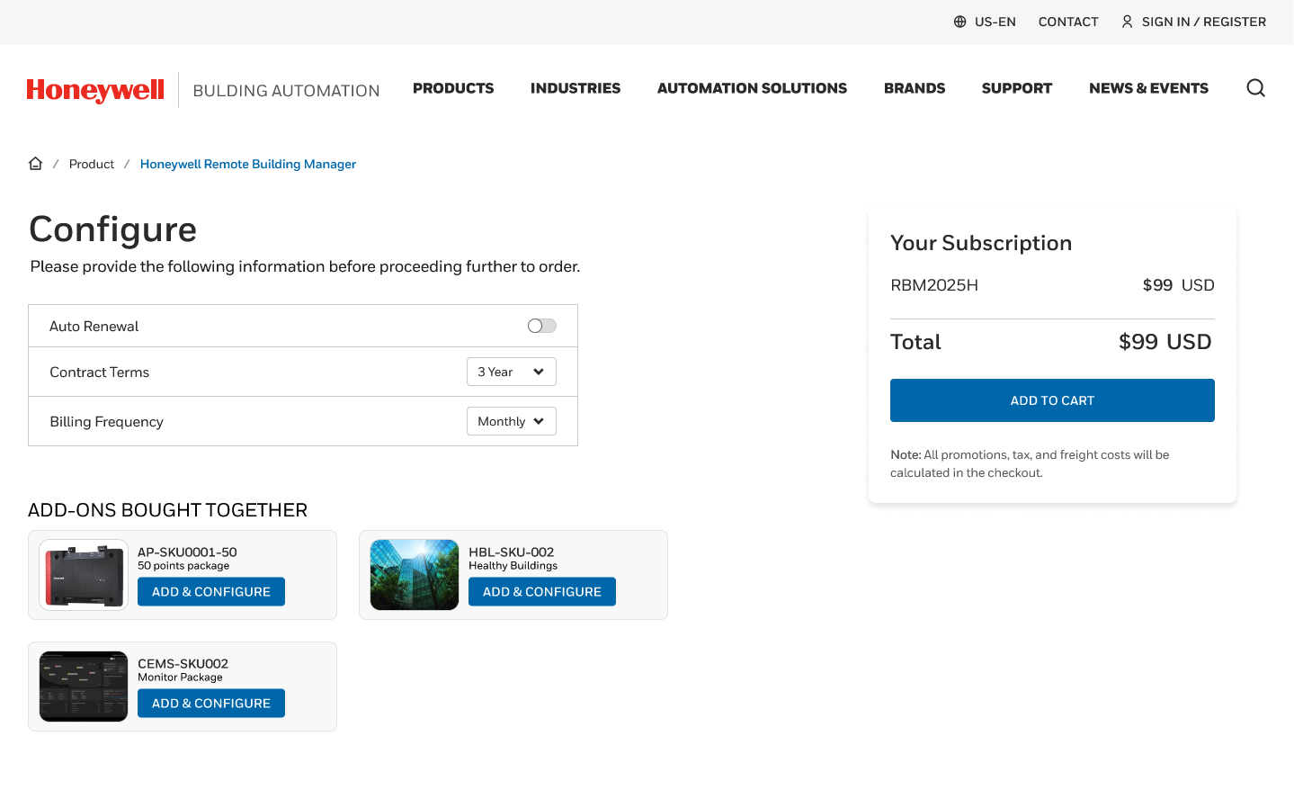
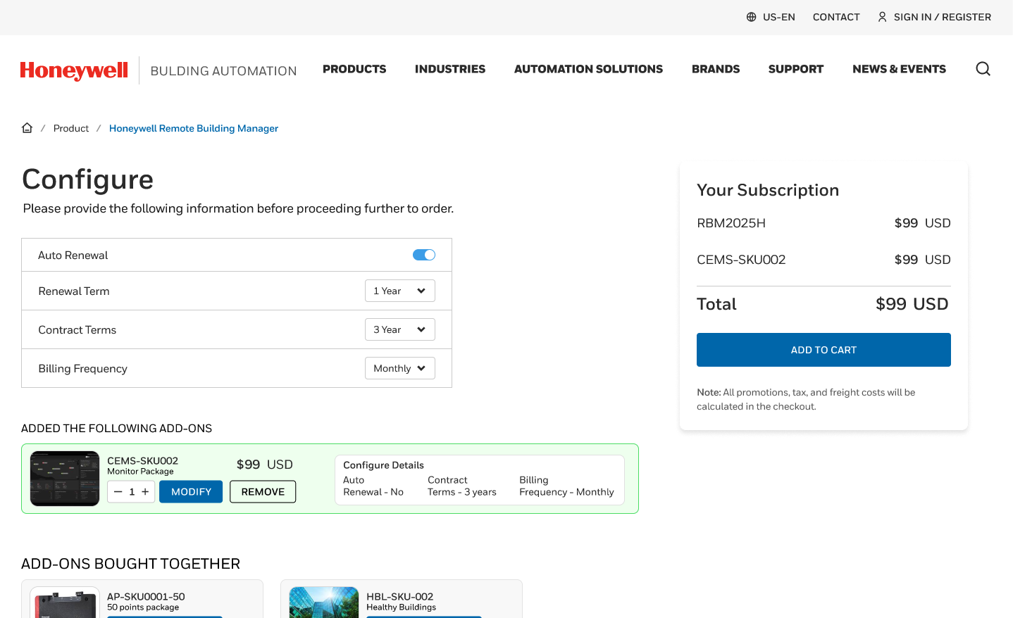
1
ordering
Include
  Via BA Ecommerce Portal mybuildings.honeywell.com
improvements
1
Titan/ E-commerce site for instant ordering - No Excel sheets/ Manual Process for Ordering. Complete ordering in minutes from current 7 days.
Order Hardware & SW subscription SKUs together- Flexible ordering system to mix and match appropriate SKUs
Single Sign-On – Single Sign-On between eCommerce Portal and Partner Portal
1
2
2

Slide 9
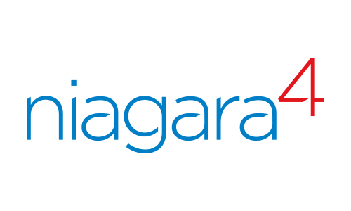


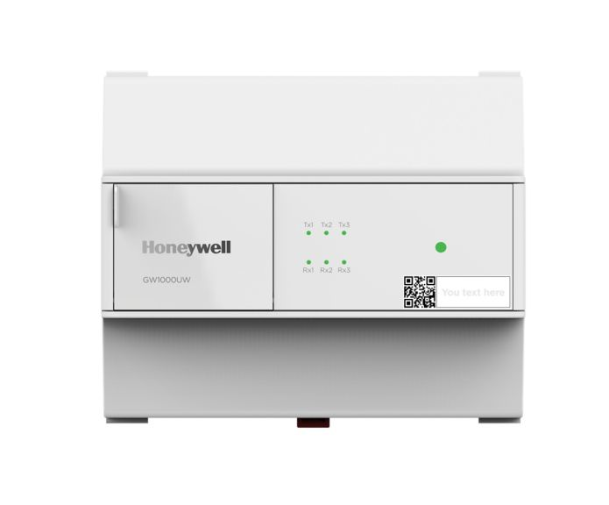
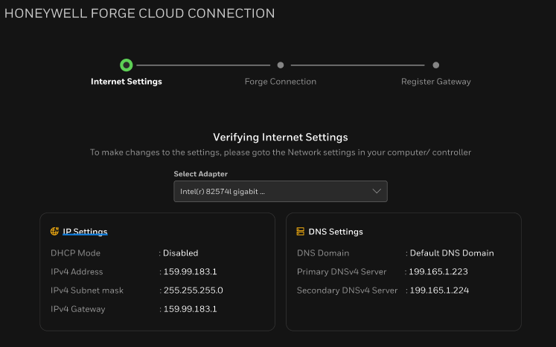
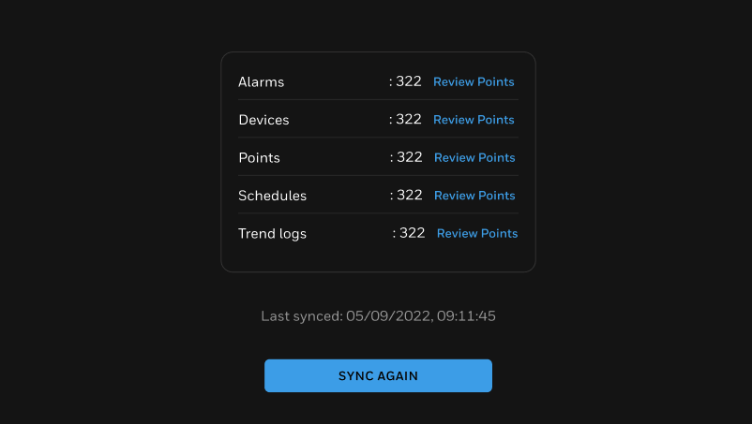
2
CONNECTING
Include
GATEWAY OPTIONS
1
SOFTWARE based GATEWAYS
GENERAL improvements
Niagara supervisors
EBI
Alerton Compass Coming soon
Supports up to 75K points
One cloud connection pipe - multiple form factors
Remote management
More than just telemetry & alarms
No Licensing requirements onsite
2
HARDWARE GATEWAYs
Forge Gateway
Simplified workflow
Supports BACnet & MODBUS
Non Niagara device
Webserver based commissioning
Up to 5000 points Supported
Setup Internet Settings
Verify Internet Connection
Collect
BMS Data
Sync with Cloud
Niagara Devices
Optimizer & JACE 9000
Up to 5k Points supported
IQ5
In-built cloud connectivity Coming soon
*Screenshots showcase Niagara based GW Workflows

Slide 10
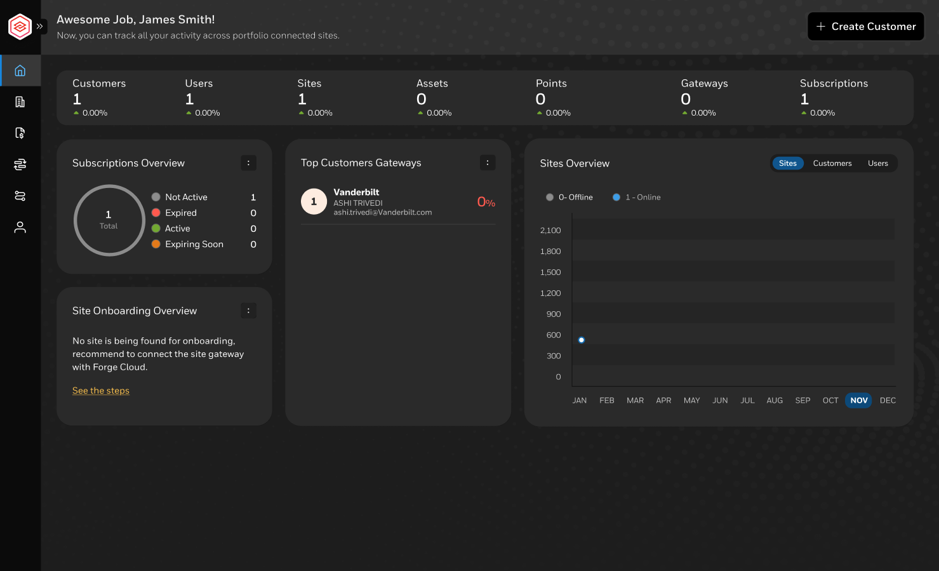
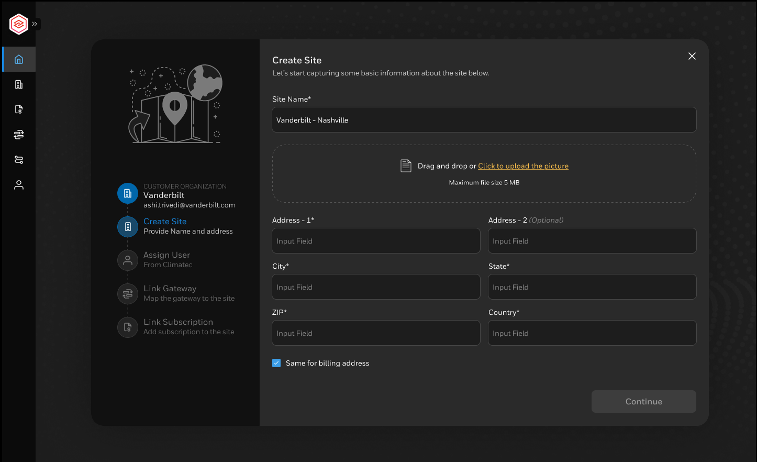
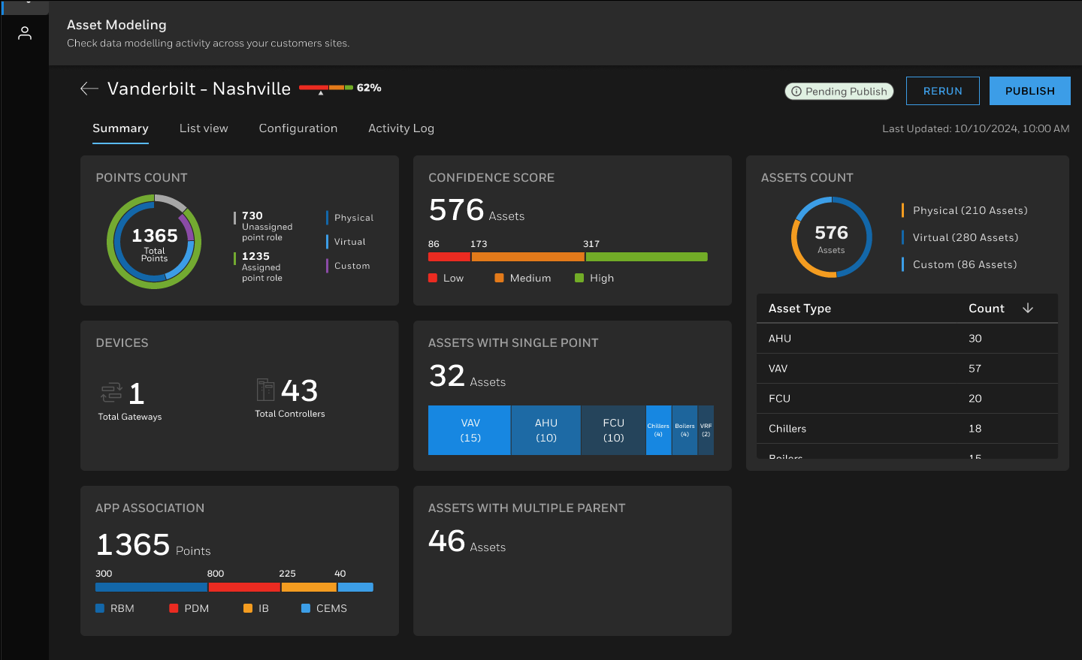
3
ONBOARDING
Include
Cockpit view for partners to look at overall portfolio of sites
  Online/ Offline sites
  Subscription status & renewals
  Trends
Remote connectivity with gateway on site.
Org and Site Onboarding via intuitive wizard. No more Excel sheets!
Ability to edit hierarchy
New Gateway Management Page with ability to view controller information including model and firmware versions
AI based automatic asset modelling on cloud.
Allows for faster accurate results. No more modelling on site!
Tool allows
  track status of automatic contextualisation
  Manually edit & fine tune model

Slide 11
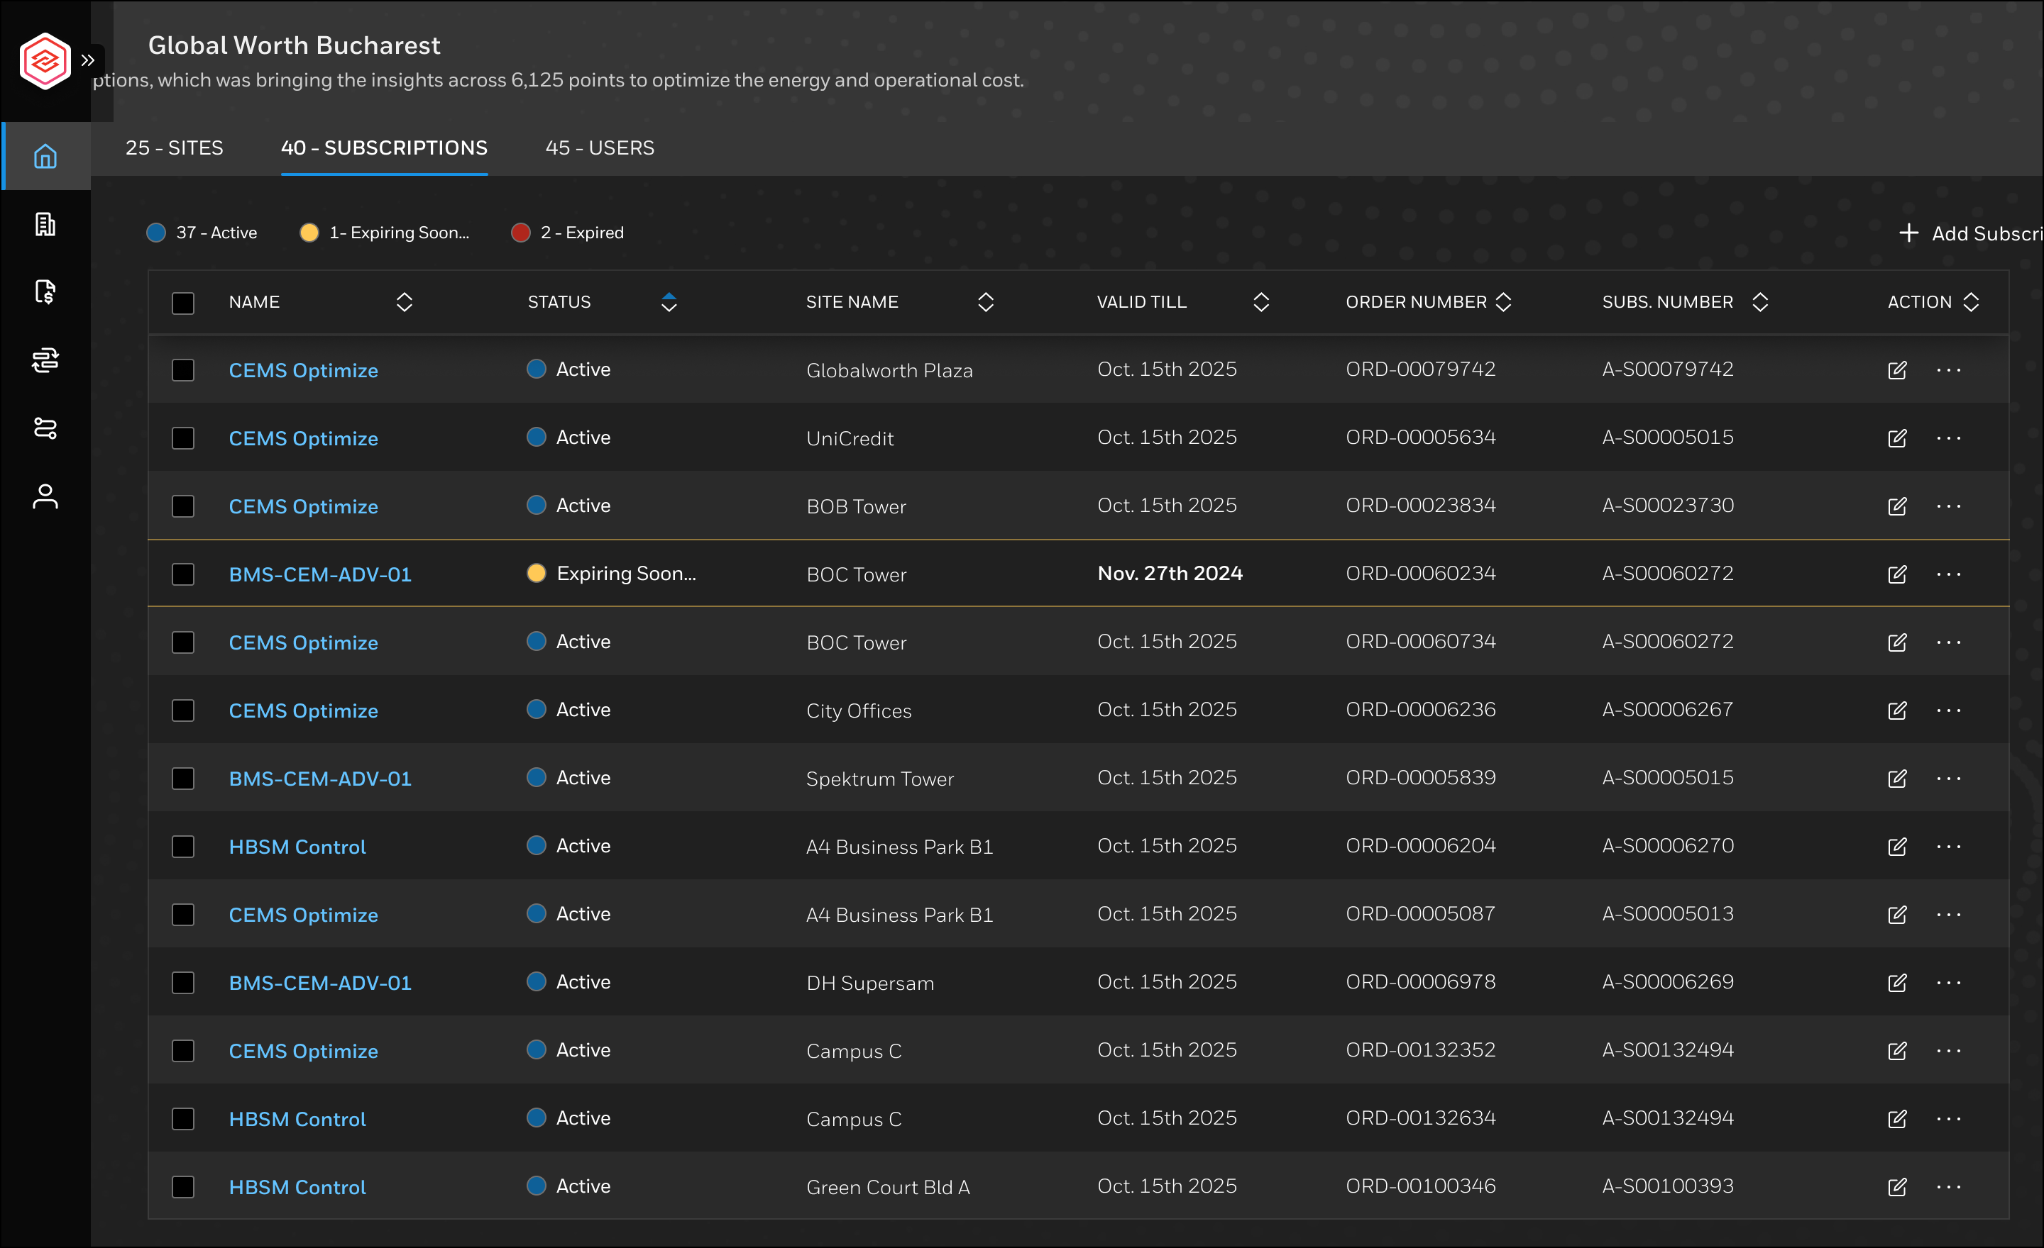
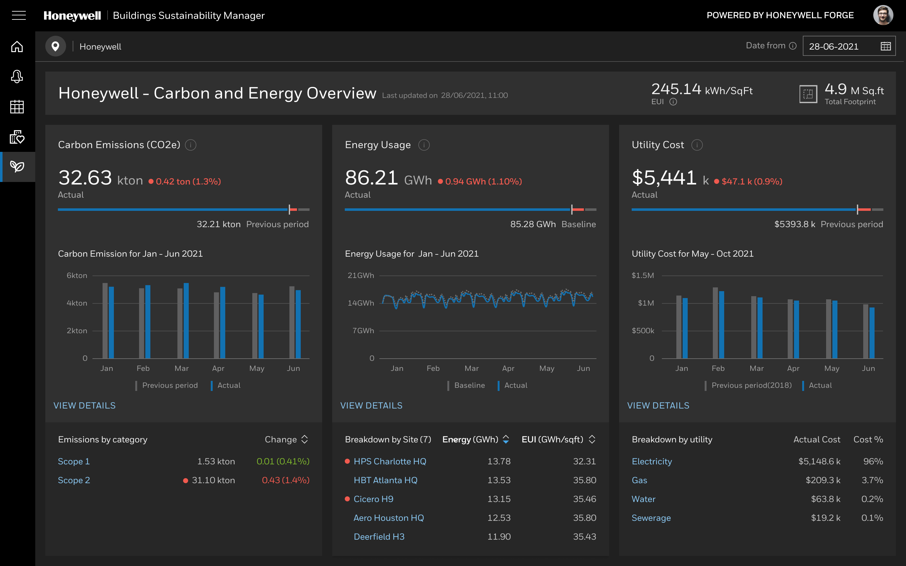
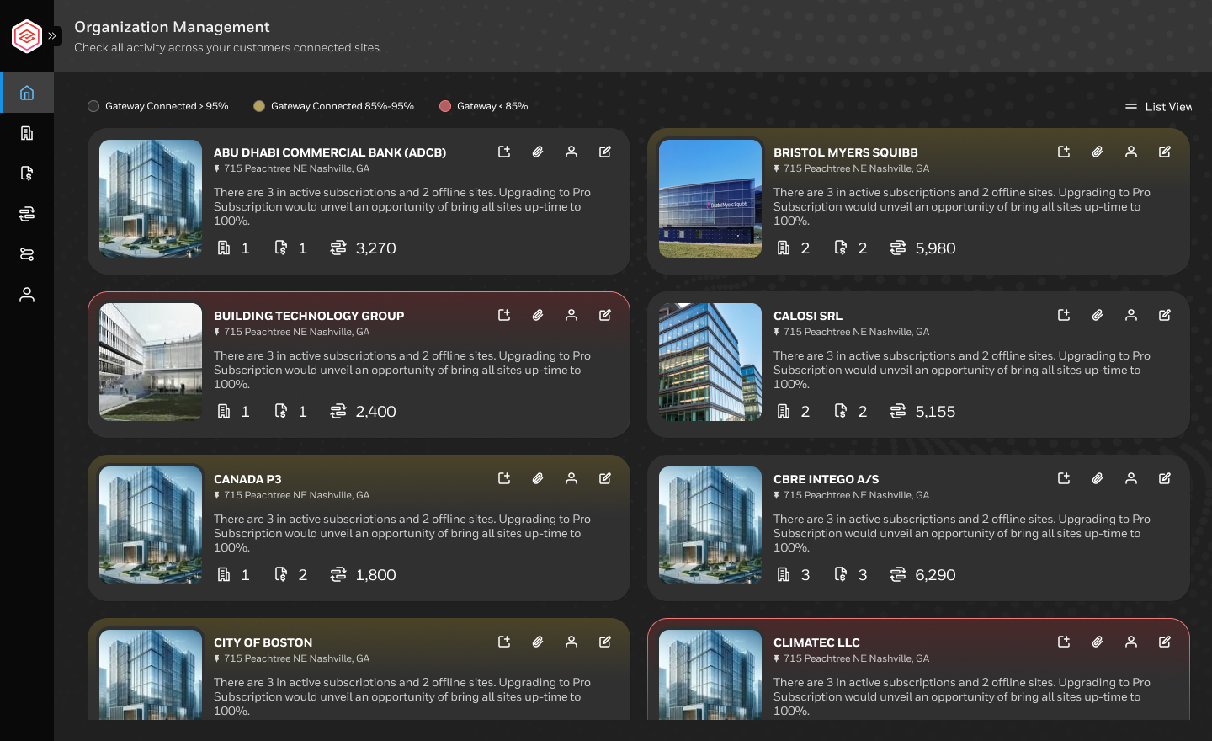

4
Include
APPS & SERVICES
PARTNER
FOCUSED
END USER
FOCUSED
END user & partner
FOCUSED
BASIC
RBM supervisor for monitoring & control
Obsolescence assessment
Opportunity assessment
ADVANCED
Predictive maintenance
Remote PPM reports
Insight & Report builder
Portfolio Manager
END USER APPS
Building KPI dashboards
Carbon & Energy Management
Power Manager
EV Manager
MANAGED SERVICES
HBOC managed services for
Alarm management
Remote triage
Remote PPM

Slide 12












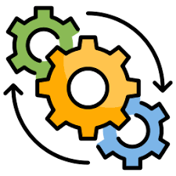










Software packaging: 2025 TIERED Offering packages
CONNECT
CONNECT+
VALUE+
ASSURANCE+
4,798
2,000
100
10*
Tier 1 Package (Digitize)
Tier 2 Package
(Expand)
Tier 3 Package
(Enterprise)
Tier 4 Package
(Assurance)
# Total Volume of Connected Buildings across all Channels
Of
Which
Of
Which
Of
Which
x
(Partner Persona)
DIGITIZATION
MONETIZATION
(End user Persona)
APPLICATIONS
Basic RBM
KPI Dashboard
Opp. Assess App
Svs case Mgmt.
Digital
PPM
OTA
Upgrades
Custom Dashboard Builder
Custom Report Builder
Carbon Optimize
Cyber Insights
Obscl. Assess App
Remote Commissioning
Analytics
Rule Engine
AI
Chatbot
Energy
Monitor
Portfolio Operations
Asset Reliability
Managed Services
PRICE
&
VALUE CAPTURE¹
50%
$0.3 - $0.5./ Pt/ Yr
3,000 Avg. Points
$1.5 - $2.50/ pt/ Yr
4,200 Points
$8 - $12/ pt/ Yr
10,000 Avg. Points
$15 - $25/ pt/ Yr
12,000 Points
25%
10%
20%
Path to $34M Gross Connected Revenue in 2025 across 4 Achetypes
© Honeywell Confidential - © 2025 Honeywell International Inc. Neither this document nor the information contained herein may be reproduced, used, distributed or disclosed to others without the written consent of Honeywell
1 – value capturee as % of price x quantity
*Model under development

Slide 13
TIERED Software PACKAGES
Starter Package
Digitize Install Base
KPI Dashboard
RBM
Remote
Opportunity & Obsolescence Tool
Connect
Add On Sale
Connect +
PdM service case mgmt. (Analytical rules)
Remote Digital PPM with compliance reports
OTA upgrade & Asset 360
Maintenance Assist
Add on Sale
CEM Monitor
CEM Optimize
Connected Power
Sustainability +
Monetize
Add on Sale
Custom Report & Dashboard Builder
Forge Insight &
Dashboard
Builder
Add on Sale
Portfolio view of multiple sites
Forge Portfolio
Manager
Add on Sale
Alarm Management
Emergency Site Monitoring
Reporting Services
Forge HBOC
Services

Slide 14
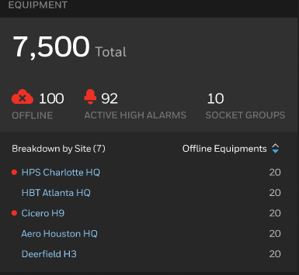
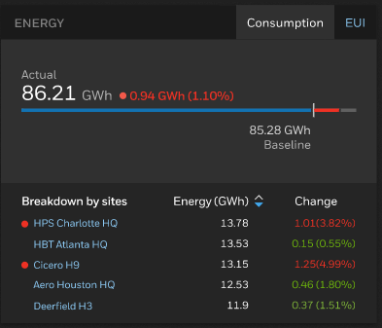
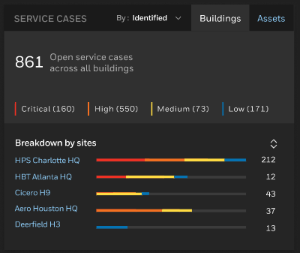
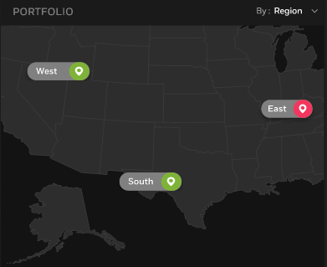
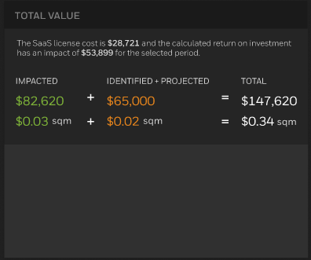
YOUR JOURNEY
Include – minimal work required
FROM Digitization TO Monetization
BUSINESS VALUE
1
CONNECT ASSETS
IN HOURS
Subscribe and Securely connect
all assets, people and processes.
AI on edge to automate
data collection
2
DATA TO
ACTIONABLE INSIGHTS
Compare performance data for buildings, regions and teams
to acquire actionable insights across entire portfolio.
AI to automate data modelling and contextualization
3
CONFIGURE
TO YOUR NEEDS
Configure dashboards
to align with organizational specific KPIs and persona.
AI for predictive modeling to identify asset failure
and maintenance needs
4
IMPROVE OPERATIONS
TO ACHIEVE YOUR GOALS
Utilize actionable insights to streamline processes, prioritize investments, drive results and reduce costs.
AI for closed loop
energy optimization
5
ACHIEVE ROI AND GROWTH AT SCALE
Always connected, continuously improving buildings.
Expand outcome focused offerings and create business expansion opportunities
TIMELINE

Slide 15
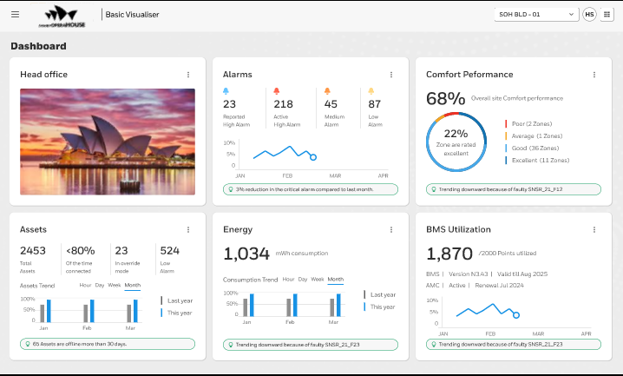
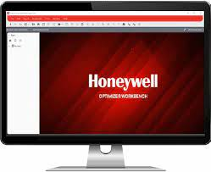
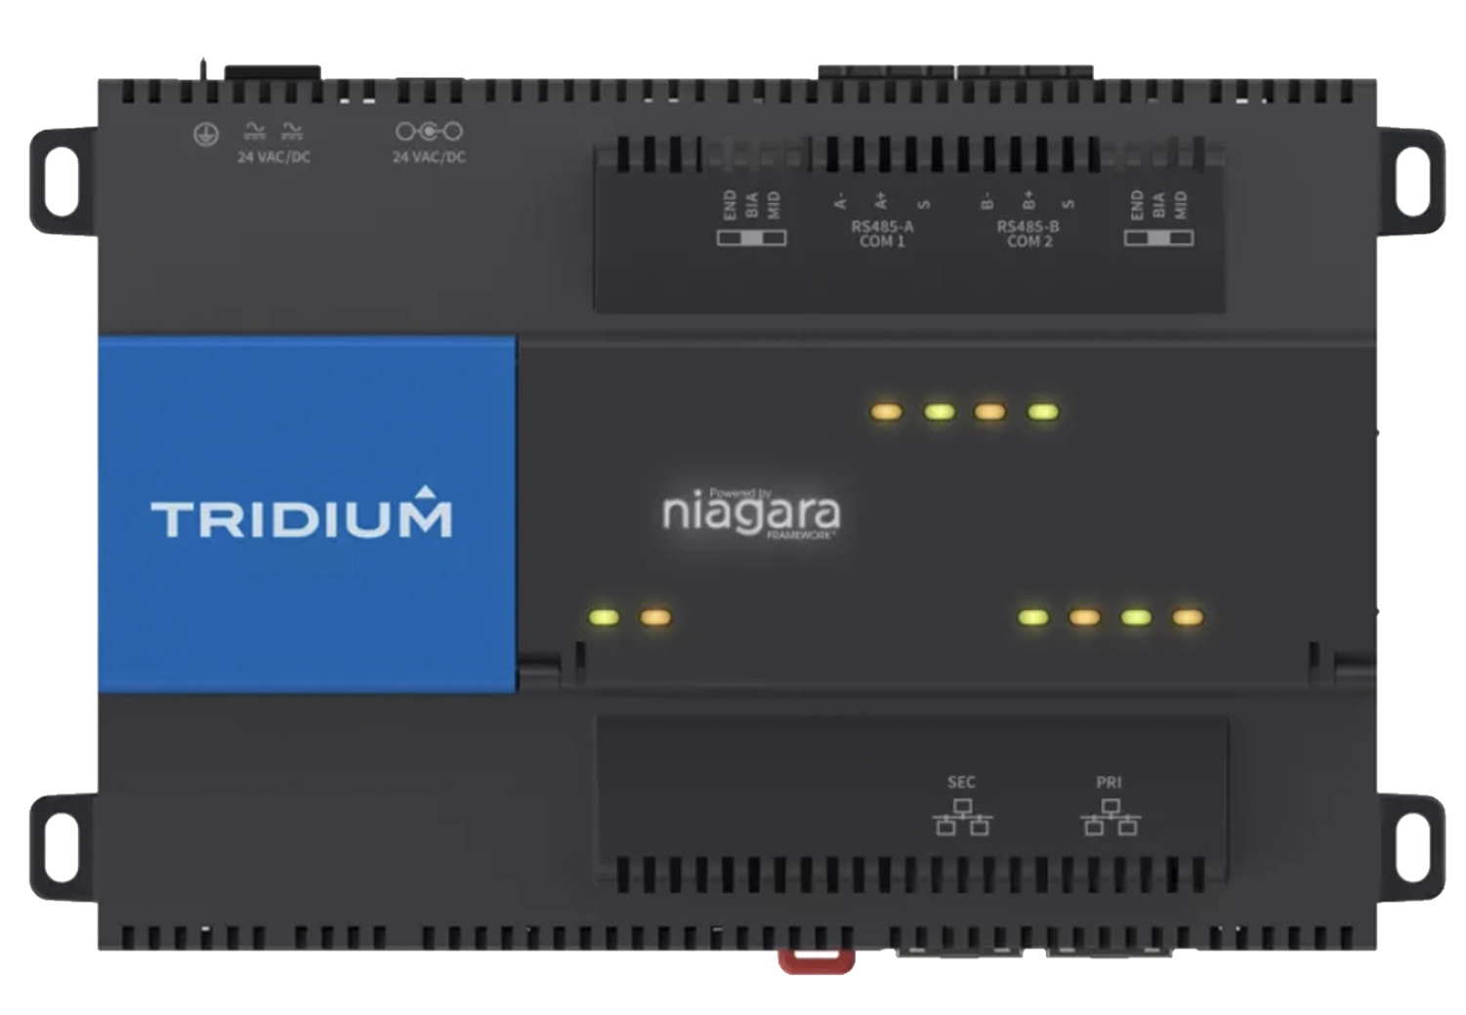
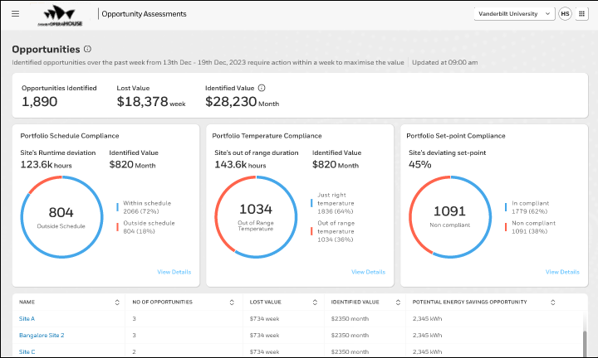
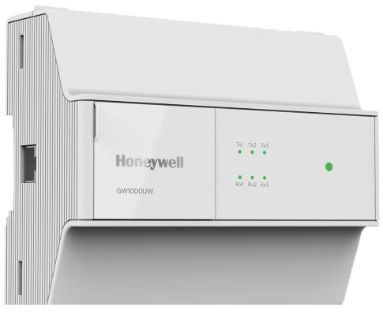
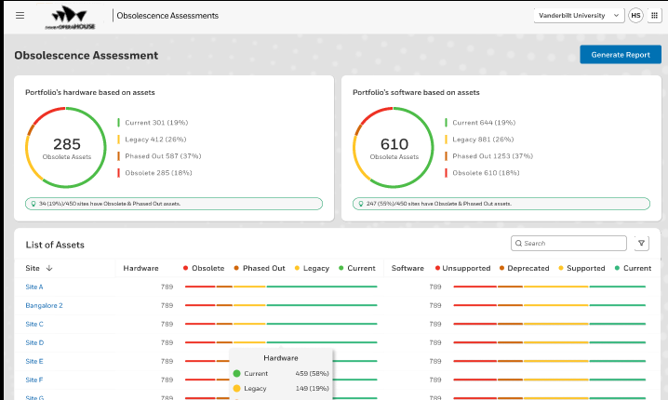
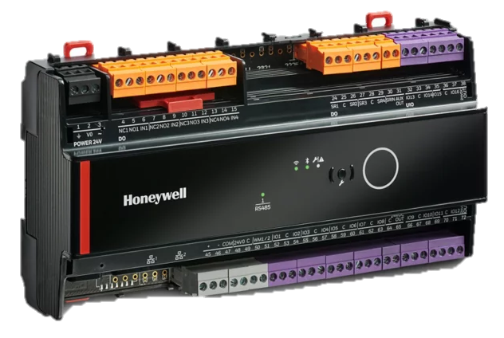

Whats coming in April 2025!
Include
CONNECTIVITY
PARTNER PORTAL
APPS
OPTIMIZER
JACE 9000
FORGE GATEWAY
IQVISION
OTIMIZER ADVANCED
New Forge Gateway – Gateway supporting BACnet and Modbus protocols for up to 3000 points
Simplified onboarding wizard – new simple UI for connecting sites to cloud
Simplified IT Config – Connection to Forge now requires only 3 URLs whitelisted and 1 Port
Remote Connectivity – Get remote connection to station by default powered by Niagara Remote
Not just telemetry data – New cloud connection now enables to access BMS Controller config information as well
Niagara Cloud Driver Licensing – Automatic licensing of Niagara cloud driver
BRAND NEW PARTNER PORTAL!
Org & site Wizard – Creation of Org, Site and users via intuitive wizard with ability to edit hierarchy. No more Excel sheets!
Cockpit view – Service providers now have the visibility to site connectivity, subscription statuses etc for all connected sites.
AI based Asset Modelling – Cloud based Automatic asset modelling with AI/ ML algorithm with the open to add manual inputs.
Gateway Management – New section to view gateways and connected devices along with option to remotely connect to gateway
2 Step workflow - Distributors selling to contractors
New Apps
KPI Dashboard – Building performance KPIs to
Opportunity Assessment – highlight opportunity for energy savings and asset lifecycle improvement
Obsolescence Assessment – Manage your customer’s risks by identifying obsolete devices
Insight Builder – Create custom dashboards and reports to help your customers’ operations
Remote PPM – Execute PPMs remotely and identify equipment that needs servicing
Existing Apps
Remote Building Manager | Predictive Maintenance | Carbon & Energy Management

Slide 16
TIERED Software PACKAGES
Starter Package
Starter Package
Digitize Install Base
KPI Dashboard
RBM
Remote
Opportunity & Obsolescence Tool
KPI Dashboard
RBM
Remote
Opportunity & Obsolescence Tool
Connect
Connect
Add On Sale
Starter Package
Connect +
PdM service case mgmt. (Analytical rules)
Remote Digital PPM with compliance reports
OTA upgrade & Asset 360
Maintenance Assist
KPI Dashboard
RBM
Remote
Opportunity & Obsolescence Tool
Connect
Add on Sale
Starter Package
CEM Monitor
CEM Optimize
Connected Power
Sustainability +
KPI Dashboard
RBM
Remote
Opportunity & Obsolescence Tool
Connect
Monetize
Add on Sale
Starter Package
Custom Report & Dashboard Builder
Forge Insight &
Dashboard
Builder
KPI Dashboard
RBM
Remote
Opportunity & Obsolescence Tool
Connect
Add on Sale
Starter Package
Portfolio view of multiple sites
Forge Portfolio
Manager
KPI Dashboard
RBM
Remote
Opportunity & Obsolescence Tool
Connect
Add on Sale
Starter Package
Alarm Management
Emergency Site Monitoring
Reporting Services
Forge HBOC
Services
KPI Dashboard
RBM
Remote
Opportunity & Obsolescence Tool
Connect

Slide 17
TIERED Software PACKAGES- Proposal from Sustainability team
In complete
Starter Package
Up to 1,500 total points |  | Up to 3,000 total points | Up to 5,000 total points | Additional 1,000 points
BMS-RBM-BASE-500 | BMS-RBM-BASE-1500 | BMS-RBM-BASE-3000 | BMS-RBM-BASE-5000 | BMS-RBM-ADD-1000
$499 | $699 | $899 | $1199 | $199
Digitize Install Base
Connect
KPI Dashboard
RBM
Remote
Opportunity & Obsolescence Tool
Add On Sale
First 600 Analytical Points | Additional 100 Analytical points
BMS-PDM-BASE-500 | BMS-PDM-ADD-100
$999 | $199
Connect +
PdM service case mgmt. (Analytical rules)
Remote Digital PPM with compliance reports
OTA upgrade & Asset 360
Maintenance Assist
Add on Sale
CEM Monitor+ (CEM Monitor, Submeter visualization, ECM identification, ROI )
CEM Optimize+ (CEM Optimize, Managed Services (HBS), CEM Monitor+)
Connected Power (TBD)
Sustainability +
Monetize
First 1 Custom Dashboard + 1 Custom Report | Additional 5 Custom Dashboards + 5 Custom Reports
Included with Tier-1
Included with Tier-1
Add on Sale
Custom Report & Dashboard Builder
Forge Insight &
Dashboard
Builder
Add on Sale
First 25 Sites | Additional 25 Sites
Portfolio view of multiple sites
Forge Portfolio
Manager
Add on Sale
Alarm Mgmt/Site | Emergency Monitoring/Site
Yet to be launched | Yet to be launched
Alarm Management
Emergency Site Monitoring
Reporting Services
Forge HBOC
Services

Slide 18
Starter package - Connect
INCLUDE
Connectivity
The solution offers three connectivity options (Niagara, EBI, Forge Gateway) with streamlined customer IT approval. It features an Onboarding Wizard for quick and easy gateway registration, along with pre-checks and diagnostic logs for efficient troubleshooting. Data collection from BMS includes telemetry points, history, alarms, schedules, and logs.
Partner Portal
The solution includes an intuitive Org & Site Wizard for creating and editing org hierarchies. A Cockpit View provides service providers with full visibility into site connectivity and subscription statuses across all sites. AI-powered Asset Modelling automates asset creation using AI/ML algorithms while allowing manual inputs. Gateway Management offers a comprehensive view of gateways, connected devices, and remote connection capabilities.
Remote Building Manager,
is an app that lets building owners and tenants monitor equipment, manage energy, remotely. It offers secure access to BMS alarms, schedules, equipment, devices, and spaces.
Obsolescence Assessment
The solution streamlines the lifecycle management process for your building's controls infrastructure, thereby mitigating the risk of failures and enhancing security. It also empowers you to support customers in making well-informed investment decisions.
Insight builder
Insight Builder is a tool to create custom dashboards and gain insights from various data sources easily. It allows detailed dashboard creation with widgets and tables, showcasing different metrics. Whether monitoring tide levels, meter consumption, or humidity, Insight Builder simplifies data analysis without complex BI tools. Insight Builder turns data into valuable insights for better decision-making and operational efficiency.
Opportunity Assessment
The solution identifies maintenance savings opportunities and finds energy savings potential through operational improvements. It aims to enhance asset lifecycle cost efficiency and discover comfort improvement possibilities. These solutions are designed to maintain building operations smoothly and efficiently, maximizing uptime.
Reports App
access to predefined reports across all building data. Including performance data, service, temperature, comfort, energy, carbon or alarm data. It allows access to all data in the system and the insight builder application allows the creation of customer-specific reports which can be generated and sent automatically.

Slide 19
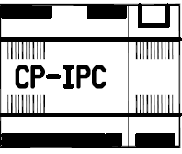

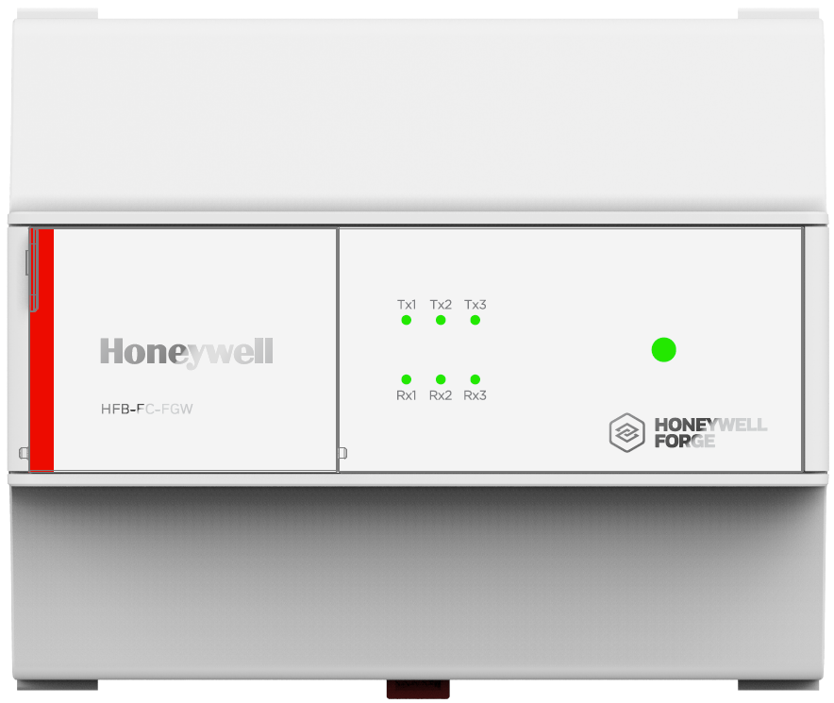

Honeywell forge gateway
INCLUDE
Elevator Pitch
Honeywell Forge Gateway is a compact device, its primary purpose is to establish a secure & seamless connection between on-premises building management devices and Honeywell Forge Cloud Platform. Honeywell Forge Gateway have Onboarding Wizard which simplifies Gateway Registration, collect & send required BMS information to Honeywell Cloud. Onboarding Wizard & reduced Firewall URLs makes onboarding faster.
On Premises/Edge
On Honeywell Forge Cloud
US Data Center
EU Data Center
UAE Data Center
Honeywell Forge Gateway
DDC
LAN
https 443
LAN
Faster customer IT approval – Just 3 URLs with PORT 443
Onboarding Wizard - Easy/Quick Gateway Registration
Pre-Checks & Diagnostic Logs – Quick Troubleshooting
Remote Connectivity – Remote GW access for troubleshooting
Remote Software/firmware updates
BMS Information Collection – Telemetry Points, History, Alarms, Schedules & logs
BACnet/TCPIP
DDC
IT Firewall
Various Honeywell Forge
SaaS Applications to improve
Operational Efficiency &
Energy Efficiency
MODBUS-MSTP/Ch1
MODBUS-MSTP/Ch2
MODBUS-MSTP/Ch3
Key Features/Benefits
Simplified Connectivity– 3 Reduced Firewall URLs with Port 443.
Connected Points– 3k (Future expansion till 5k Points)
BMS Discoverable Points– 10k
Protocol Support– BACnet/IP, MODBUS/MSTP ( 3 channels)
OTA – Supports remote, over the air upgrades
Installation – Supports DIN rail mounting and wall/panel mounting (four screws)
Dimension (L x W x H) – 5.7 x 4.3 x 2.04 inches (145.8 x 110 x 52 mm)
Remote Device Access:- Forge Remote
Troubleshooting- Diagnostics Logs
MODBUS Devices Supported
BACnet Devices Tested
HONEYWELL
HONEYWELL
ALERTON
LOYTEC
TREND
TRIDIUM
EASTRON
Add Product Brand LOGOs here
iSMA CONTROLLER
Quick Onboarding & Remote Troubleshooting

Slide 20
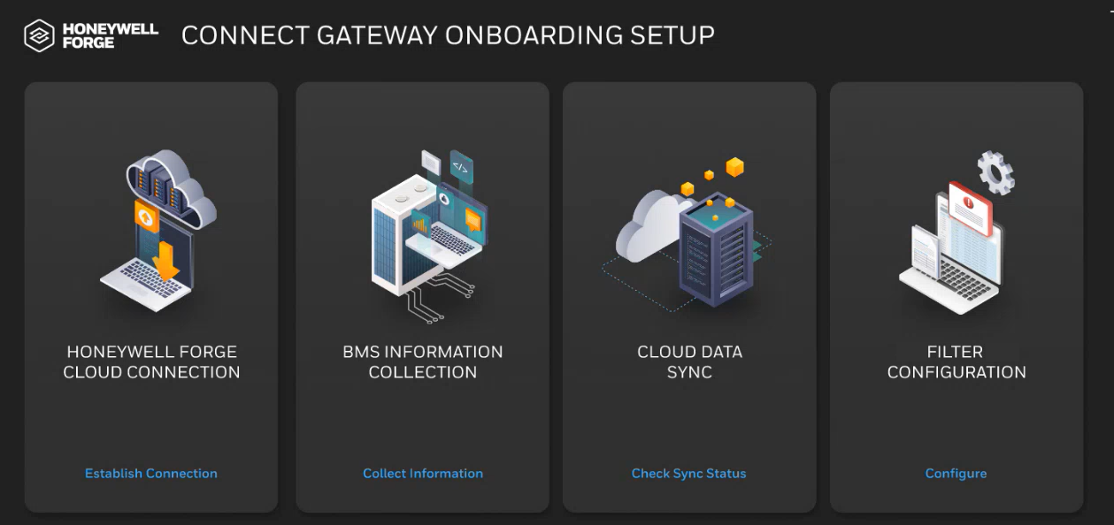

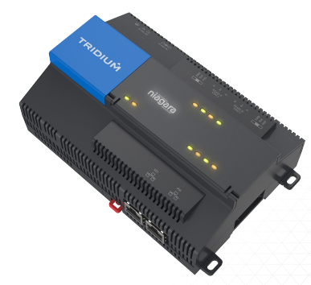
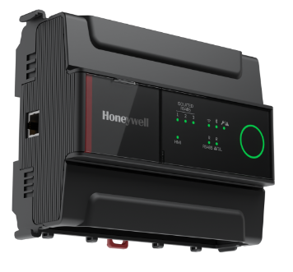
NIAGARA BASED Gateways
INCLUDE
Elevator Pitch
Niagara Based Supervisors & Controllers consisting Cloudlink modules provides device registration & a secure connection to Honeywell Forge Cloud Platform. The station running Cloudlink contains references to the devices on the network. These devices can contain information such as Alarms, Histories, Points, System Commands and Events. Data is sent from the station to Honeywell Forge Cloud Platform. New Niagara Based Gateways have Onboarding Wizard which simplifies Gateway Registration, Collect & send required BMS information to Honeywell Cloud. Onboarding Wizard & reduced Firewall URLs makes onboarding Faster
Simplified Cloudlink Licensing – Auto Point Licensing via API.
Faster customer IT approval – Just 3 URLs with PORT 443
Onboarding Wizard – Easy/Quick Gateway Registration for Field Techs
Pre-Checks & Diagnostic Logs – Quick Troubleshooting for Field Techs
Remote Connectivity – Remote Troubleshooting
BMS Information Collection – Telemetry Points, History, Alarms, Schedules & logs
Site1
On Premises/Edge
N4
On Honeywell Forge Cloud
N4 Supervisor
US Data Center
EU Data Center
UAE Data Center
Supported Versions
Niagara Version 4.14
Optimizer Supervisor – 10k Connected Points
Optimizer Adv Controller – 7.5k Connected Points
JACE9000 – 10k Connected Points
IQVISION
JACE8000?
IT Firewall
Site 2
https 443
Various Honeywell Forge
SaaS Applications to improve
Operational Efficiency &
Energy Efficiency
JACE9000
Site 3
Optimizer Adv Controller

Slide 21
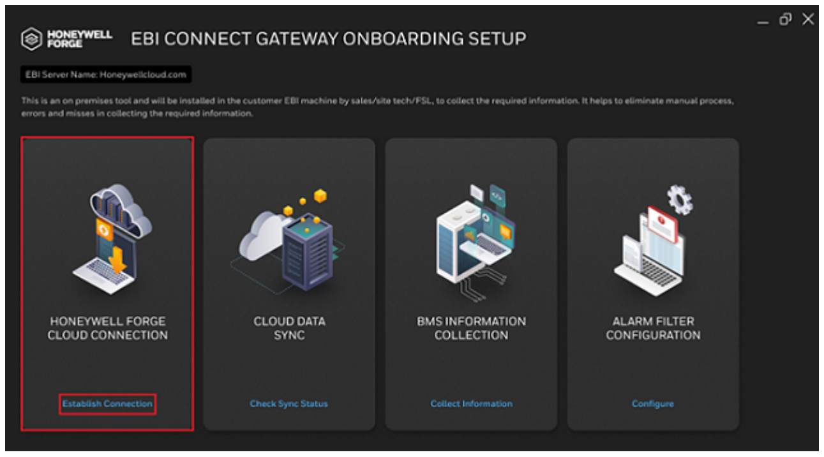
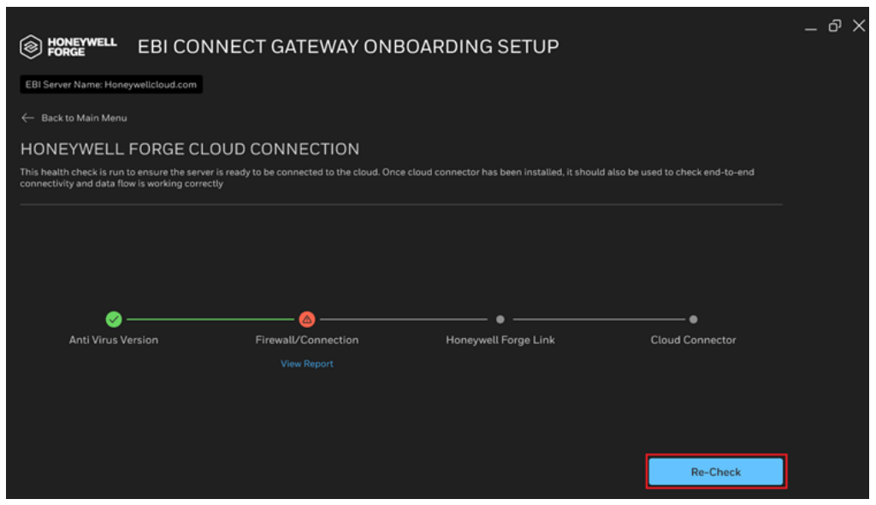
EBI Connect App
INCLUDE
Elevator Pitch
Honeywell EBI Connect App is a simplest, fastest, secured way to connect Enterprise Building Integrator (EBI) to Honeywell Forge Cloud. EBI Connect App is not just a cloud connector, it has more features such as pre-checks, diagnostics logs & onboarding wizard etc which makes onboarding easy & quicker for field techs.
Faster customer IT approval – Just 3 URLs with PORT 443
Onboarding Wizard – Easy/Quick Gateway Registration for Field Techs
Pre-Checks & Diagnostic Logs – Quick Troubleshooting for Field Techs
Remote Connectivity – Remote Troubleshooting with Diagnostic Logs
BMS Information Collection – Telemetry Points, History, Alarms, Schedules & logs
On Premises/Edge
On Honeywell Forge Cloud
US Data Center
EU Data Center
UAE Data Center
EBI
https 443
IT Firewall
Various Honeywell Forge
SaaS Applications to improve
Operational Efficiency &
Energy Efficiency
EBI Supervisor
with EBI Connect App
Key Features:
EBI Connected Points
10k Points with History Backfill.
75k Points without History Backfill
Supported EBI Versions –
EBI R600.1 CU3
RBI R610.1 CU3
EBI R700.2 CU1

Slide 22



HONEYWELL FORGE SUSTAINABILITY⁺ FOR BUILDINGS
CARBON And ENERGY MANAGEMENT
TRACKS AND CONTROLS SILOED ENERGY AND CARBON DATA
Monitors live meter data for CO2 emissions, energy and utilities and manages utility bills and tenant billing
INTEGRATES WITH ANY BMS
Manages alarms and alerts, monitors points, adjusts schedules and proactively controls building
PRIORITIZES THE MOST
EFFECTIVE WAYS TO SAVE
Crafted designer guidance (this is NOT a content slide)
For the following 10-11 slides, please create a template similar to this one to house the content, presume this will need a Stock image purchase please let Ashley know though Scott/Holly if unsure please check with Ashley.
Gains energy efficiency and improves resilience by continuous optimization of energy consumption by building assets
DATA INPUTS USED BY APPLICATION
Live Energy Meter
Utility Bill

Slide 23
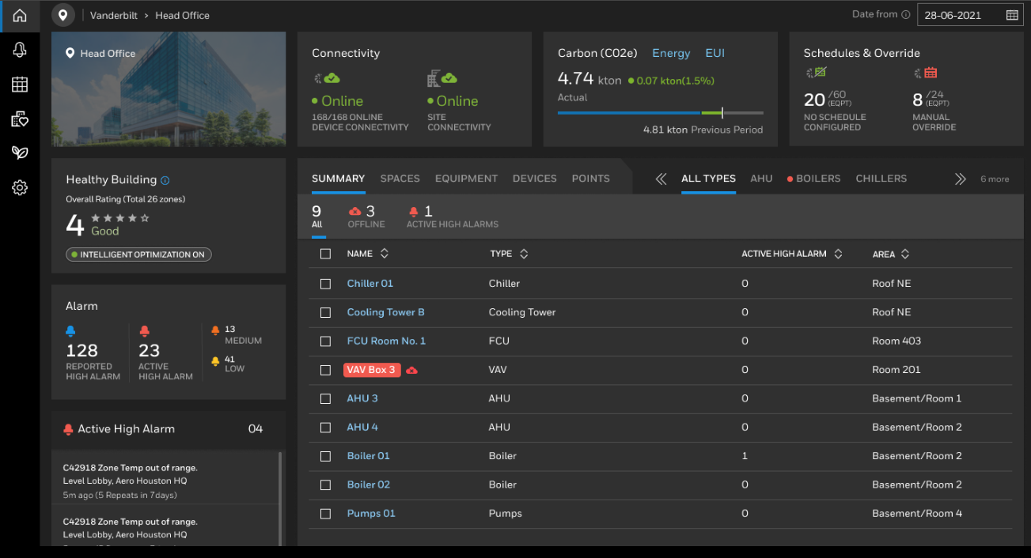
Remote Building Manager
The Remote Building Manager (RBM) is a cloud app that lets building owners and tenants monitor equipment, manage energy, and reduce costs remotely. It offers secure access to BMS alarms, schedules, equipment, devices, and spaces.
Include
Key Features/Benefits
Zero engineering: RBM exclusively utilizes the virtual model provided by the data fabric, requiring no supplementary configuration.
System agnostic: Does work on top of Niagara based systems, EBI, 3rd party.
Remote Monitoring & Control: Site and portfolio wide dashboard views with anytime, anywhere control
Intuitive Dashboards: Visualize real-time details as well as trends about comfort, energy, alarms, and KPIs
Point, Schedules & Alarms: Easily view and edit schedules, alarms, and setpoints by list, site, zone, or equipment level

Slide 24
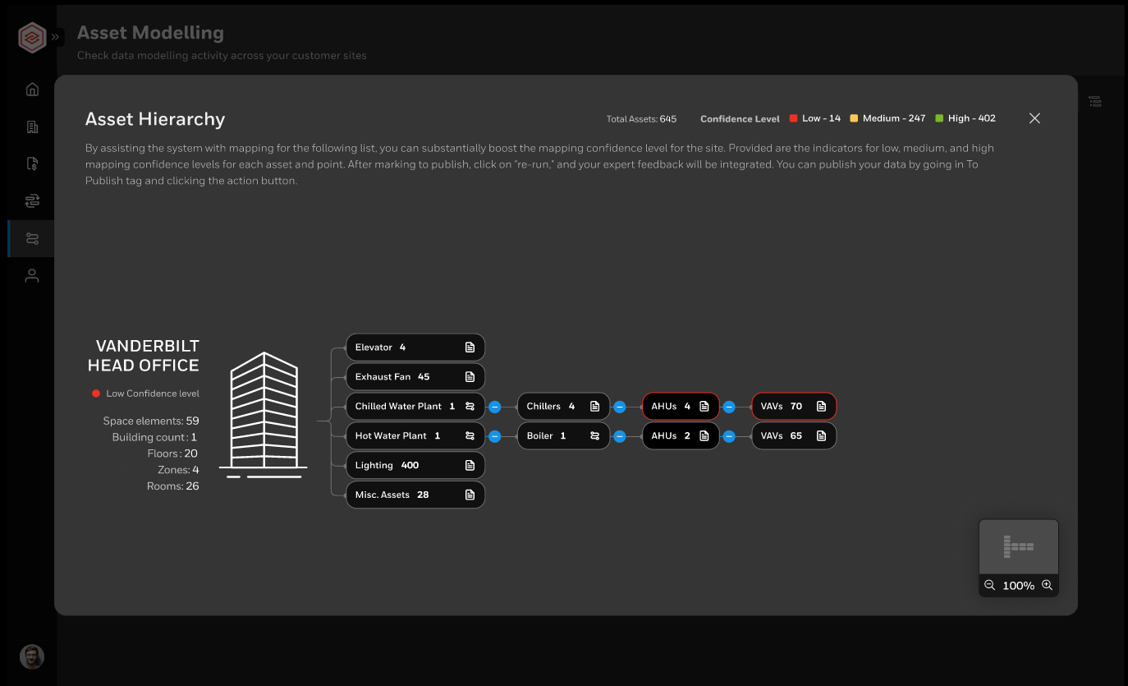
PARTNER PORTAL - ASSET MODELING
Include
The Data Fabric creates, stores, and manages a virtual model of the building management system. It uses a Honeywell ontology model to standardize data for machine readability. Leveraging AI, it tags data and integrates sources for visualization, fault detection, energy analysis, and predictive maintenance by defining system classes, relationships, and parameters.
Key Features/Benefits
AI assisted: During the modeling process, the data fabric maps data points from the building management system to point roles within the ontology model. This process is automated and continuously enhanced by AI. The initial mapping considers aspects such as point naming, unit, controller assignment, and BMS graphics. Users can make final adjustments, and if the algorithm cannot assign a point, users will be prompted to assist. This feedback trains the AI-assisted tagging system.
Honeywell ontology model: An ontology model is used to create a unified representation of various elements within a system, such as assets, devices, and their relationships. It allows for the integration of data from different sources and supports various applications like fault detection, energy analysis, and predictive maintenance. The model includes classes, relationships, and parameters that define the characteristics and interactions of the elements within the system.
Self serve: Data Fabric is embedded in the onboarding portal and therefore available for users with the appropriate access permissions.
Extensible: The Honeywell ontology model is extensible, and thus not confined by limitations regarding assets, asset types, or point roles.

Slide 25
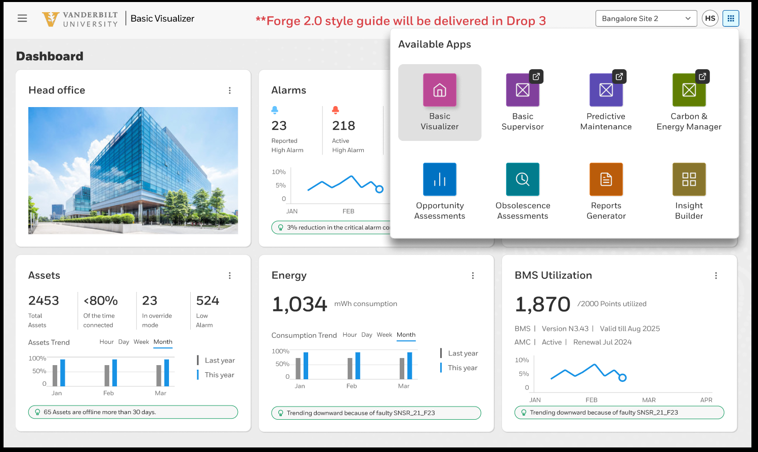
KPI DASHBOARD
Include
Experience the future of building management with our Unified Portal. Seamlessly manage and operate your building from one place, gaining unparalleled insights into energy, asset, and building performance that truly make a difference. Effortlessly generate comprehensive reports and create customized widgets and dashboards tailored to your specific needs and verticals. Simplify your operations and enhance decision-making with our all-in-one solution.
Key Features/Benefits
Integrated platform: The Unified Portal consolidates various applications and tools into a single platform, providing a seamless user experience. This integration allows users to navigate effortlessly between different products and access all necessary data in one place.
Centralized remote operation: The Unified Portal facilitates better collaboration among team members by providing a centralized platform for sharing information and insights. This feature enhances communication and coordination, leading to more effective building management.
Customizable dashboards: Users can create and customize dashboards to visualize key metrics and data points relevant to their needs. This feature enhances data analysis and decision-making by providing a comprehensive view of building operations.
Real-time data insights: The portal provides real-time access to data from various building systems and sensors. This capability enables users to monitor performance actively and respond promptly to any issues.

Slide 26
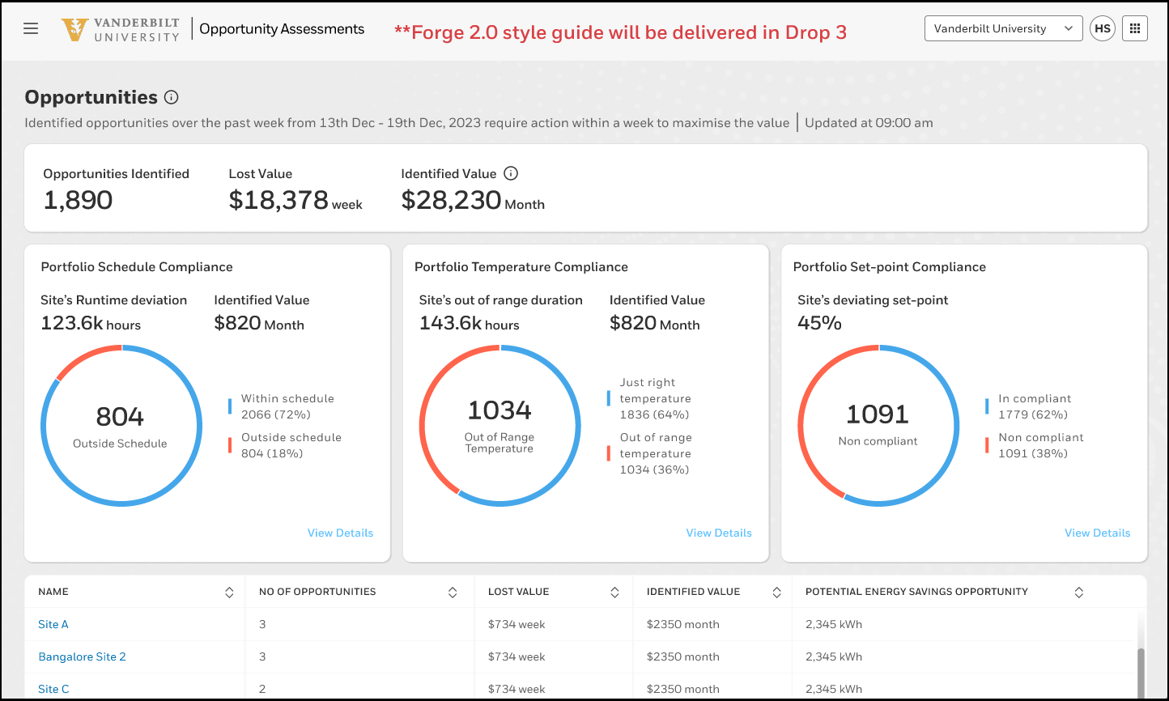
Include
OPPORTUNITY ASSESSMENT
Unlock the full potential of your building with our cutting-edge solutions. By providing insights based on data, you can leverage one of the services within the Forge ecosystem to gain unparalleled advantages. Discover maintenance savings opportunities and identify energy savings potential through operational improvements. Enhance your asset lifecycle cost efficiency and uncover comfort improvement opportunities. Maximize uptime with our innovative solutions designed to keep your building running smoothly and efficiently.
Key Features/Benefits
Data driven: The Opportunity Assessment App uses building telemetry data and ontology model data within the assessment.
Benchmarking with standards: The app compares building performance against industry standards to identify underperforming areas and provide actionable insights. This benchmarking ensures optimal efficiency by evaluating assets' performance against typical values from similar assets.
Estimating Dollar Impact: By analyzing telemetry data and benchmarks, the app quantifies potential savings in monetary terms, helping managers make informed decisions on investments and track financial benefits, such as savings from unusual set-points
Converting Potential to Savings: The app links identified opportunities to specific products or services, like recommending Honeywell Forge for predictive maintenance, reducing energy wastage, and extending asset lifespan, ensuring potential savings are effectively realized.

Slide 27
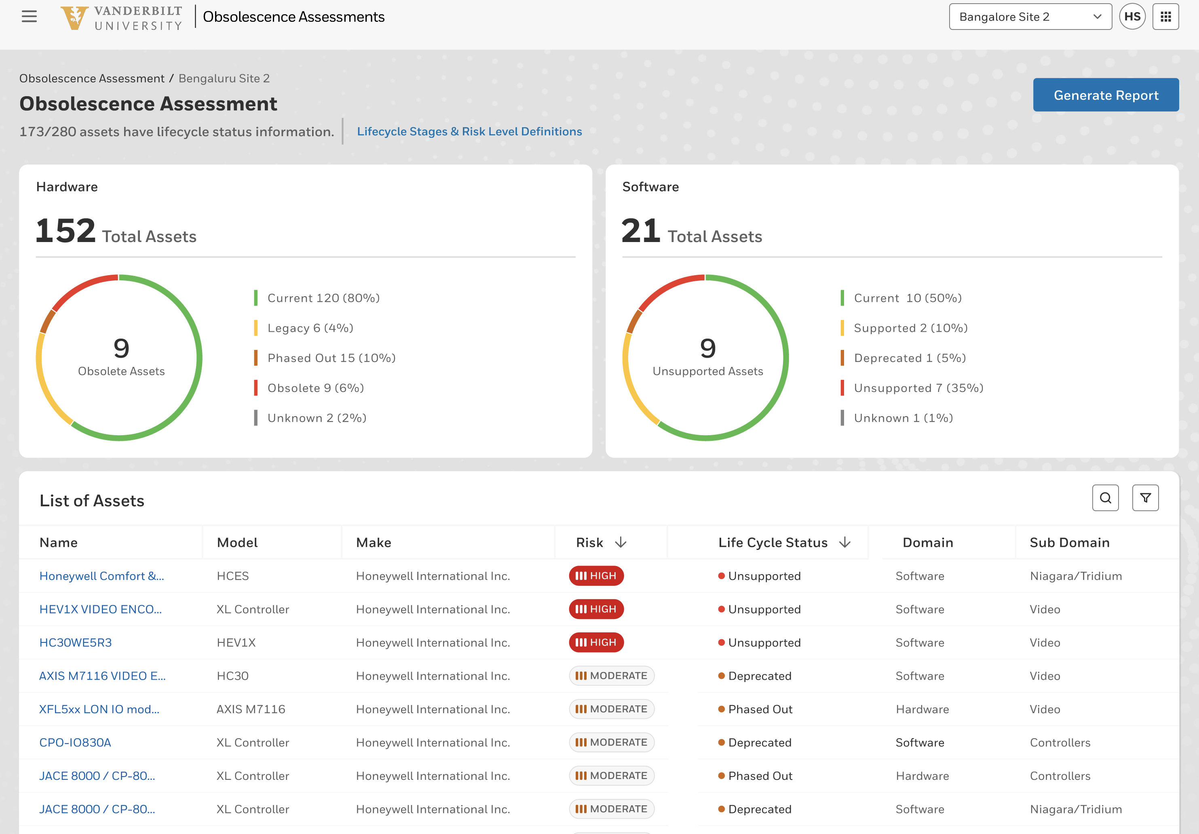
OBSOLESCENCE ASSESSMENT
Include
( To Partner)
The Honeywell Obsolescence Assessment App is a powerful tool that helps keep your customers' building infrastructure current and effective. It provides insights into asset current lifecycle status, enabling proactive planning for replacements and updates.
The app facilitates advanced planning of software and hardware upgrades, reducing the risk of failures and enhancing security. It enables you to assist customers in making informed investment decisions, improving customer engagement, and identifying revenue opportunities by addressing obsolete equipment early.
Simplify and secure your building's asset lifecycle management with the Obsolescence Assessment App.
Key Features/Benefits :
Current data driven: The asset/device status within the Obsolescence Assessment App is always up to date.
Asset lifecycle status Assessment: Displays the lifecycle state of controllers/software with associated risks and actionable recommendations.
Upgrade Recommendation: Identifies Obsolete assets suggests replacement options for the assets.
Obsolescence Assessment Report : Generate and export site asset obsolescence assessment report in PDF and Excel formats
Enhance Customer Satisfaction & Engagement : Enables proactive asset obsolescence management, aids customer budget planning
Uncover Additional Revenue Opportunities :Identifies obsolete equipment requiring upgrades to enhance revenue potential.

Slide 28
OBSOLESCENCE ASSESSMENT
Include
( To Customer)
The Honeywell Obsolescence Assessment App is a powerful tool that helps keep your building infrastructure current and effective. It provides insights into asset current lifecycle status, enabling proactive planning for replacements and updates.
The app facilitates advanced planning of software and hardware upgrades, reducing the risk of failures and enhancing security. It enables you to in making informed investment decisions and addressing obsolete equipment early.
Simplify and secure your building's asset lifecycle management with the Obsolescence Assessment App.
Key Features/Benefits :
Current data driven: The asset/device status within the Obsolescence Assessment App is always up to date.
Asset lifecycle status Assessment : Displays the lifecycle state of controllers/software with associated risk levels and actionable recommendations.
Upgrade Recommendation: Identifies Obsolete assets suggests replacement options for the assets.
Obsolescence Assessment Report : Generate and export site asset obsolescence assessment report in PDF and Excel format.
Reduce Downtime Risk , Enhance Security : Proactive asset obsolescence management reduces failure risk and enhance security
Informed Investment Decisions: Empowers you to make well-informed investment choices by identifying and addressing obsolete equipment proactively.
Streamlined Lifecycle Management: Simplifies and secures the management of your building’s asset lifecycle with an easy-to-use interface.

Slide 29
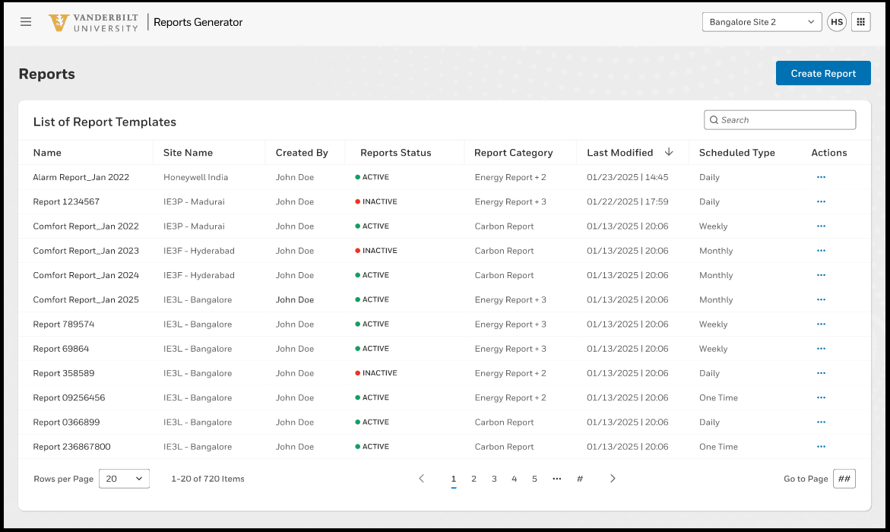
REPORTS GENERATOR
Include
Via the Reporting App, users have access to predefined reports across all building data. This includes building performance data, service reports, temperature and comfort reports, energy and carbon reports or alarm reports. The report engine allows access to all data converging in the system and the Insight builder application allows the creation of customer-specific report templates. Reports can be generated and sent automatically via a time program.
Key Features/Benefits
Report templates, access to predefined report templates
Custom templates, being able to create custom reports and report templates
Scheduled reports, being able to schedule reports

Slide 30
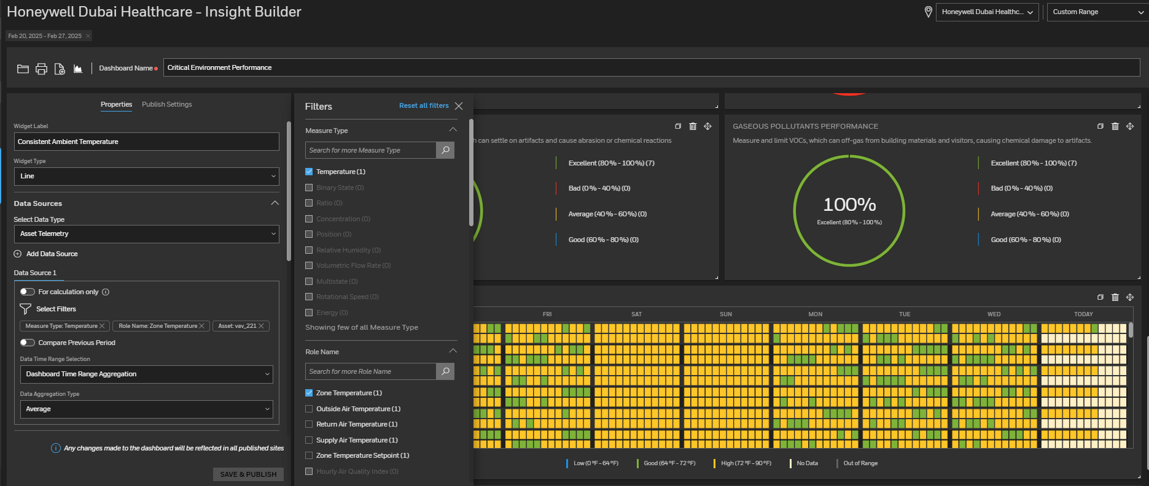
INSIGHT BUILDER
Include
Insight Builder is a tool that lets users create custom dashboards and gain insights from various data sources easily. Part of the Unified App, it allows detailed dashboard creation with widgets and tables, showcasing different metrics. Whether monitoring tide levels, meter consumption, or humidity, Insight Builder simplifies data analysis without complex BI tools. With its user-friendly interface and templates, creating and publishing dashboards is quick, improving customer engagement and responsiveness. Insight Builder turns data into valuable insights for better decision-making and operational efficiency.
Key Features/Benefits
Customizable Dashboards: Easily create site-specific dashboards and widgets to visualize data as needed.
Pre-built Templates: Utilize various templates like bar charts, column charts, tables, and donuts for quick and informative dashboards.
Data Integration: Access and analyze telemetry data, assets, service cases, faults, alerts, spaces, and rules.
Report Generation: Generate and print PDF reports directly from dashboards for stakeholder sharing.
Asset and Sensor Data Utilization: Use sensor and asset data to monitor and manage portfolios effectively.
User-friendly Interface: Enjoy a simple workflow for dashboard creation without complex BI tools.
Enhanced Customer Engagement: Improve customer engagement and responsiveness while reducing labor and licensing costs for service providers and users.

Slide 31
Connect +
done
Predictive Maintenance
The Predictive Maintenance App aims to lower the operating and maintenance costs of assets while enhancing equipment uptime, service operational efficiency, and occupant comfort. This application supports the shift from planned and reactive maintenance to on-demand maintenance. Issues are quickly identified by continuous data analysis and can be addressed promptly. Users can remotely monitor real-time values and trends of asset properties and examine issues in related assets to determine root causes. The app also enables remote control of device setpoints and configurations for troubleshooting and allows service cases to be assigned to appropriate teams as required.
Maintenance Assist (coming soon)
is a Forge-enabled, mobile Generative AI-based digital assistant designed to guide internal field service technicians in maintaining, troubleshooting, and repairing critical assets through an interactive natural language interface. The application allows users to ask maintenance-related queries and receive immediate responses, helping to address customer issues more quickly
Forge Sustainability +
for Buildings is a scalable suite of applications designed for organizations and entities that need to meet their sustainability goals – reducing energy use and carbon impact. It can help simplify reporting and provide an operating system for the building to help achieve energy reduction targets while adhering to guidelines and regulations.
Carbon and Energy is designed to monitor, control and optimize energy use and carbon impact. It digitizes the energy consumption data from all utilities and energy meters to capture portfolio’s scope 1 & 2 carbon emissions and improves energy efficiency through autonomous energy conservation measures.
Remote PPM
Our Honeywell Building Operations teams offer remote functional tests as part of planned maintenance, based on SFG 20 service plans. Detailed service reports are generated, including necessary repair, replacement, and performance improvement plans.

Slide 32
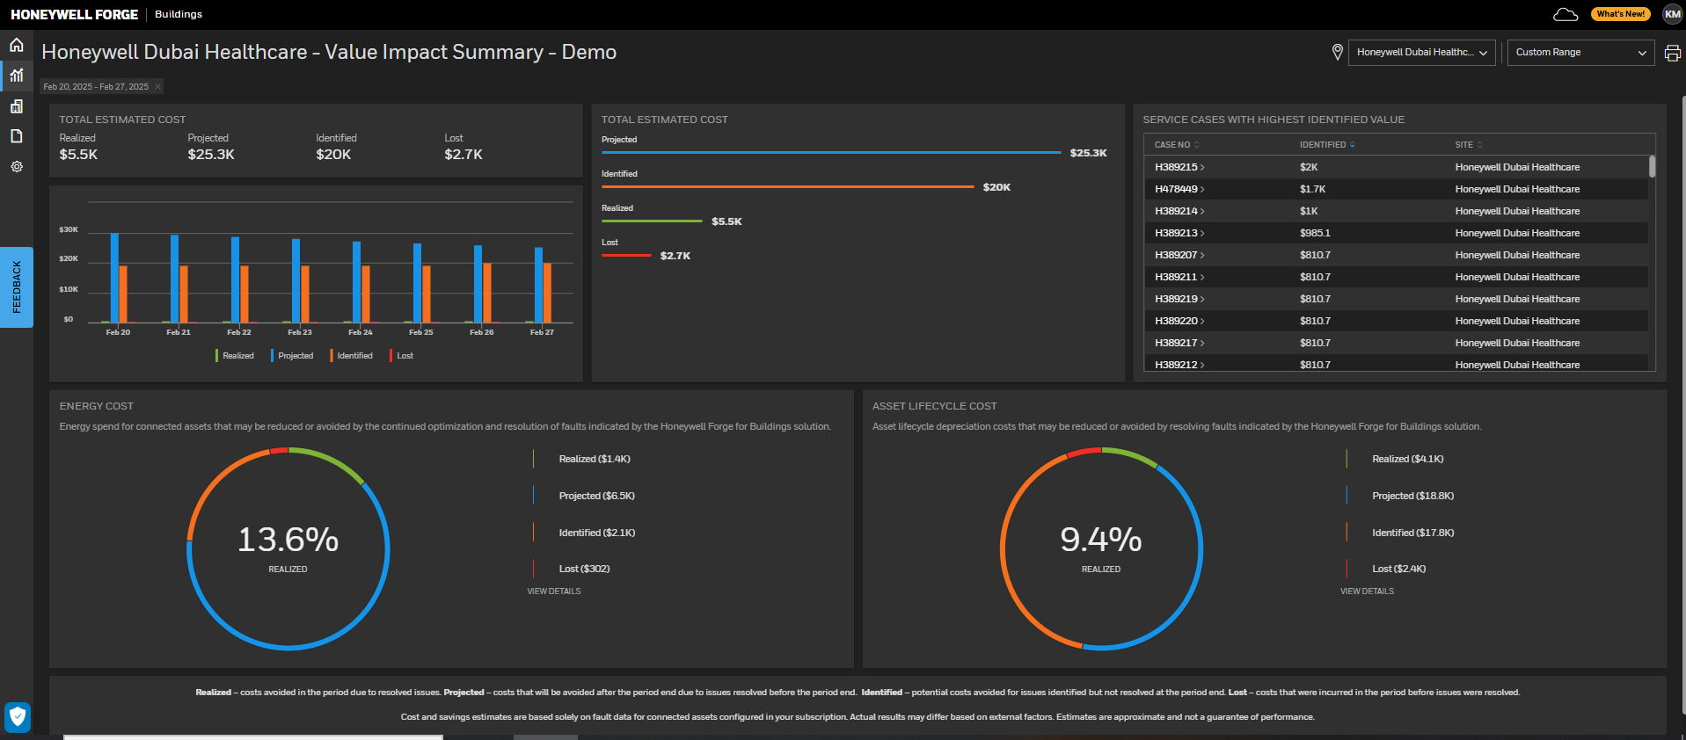
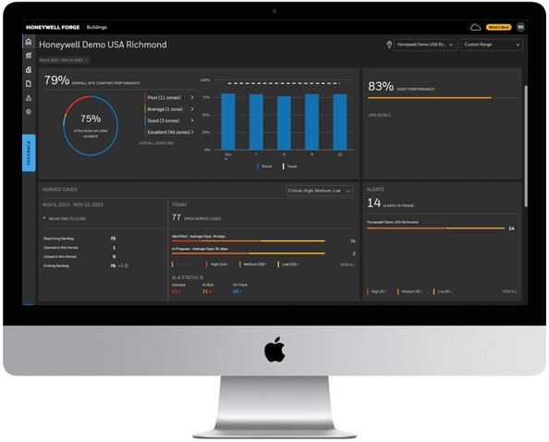
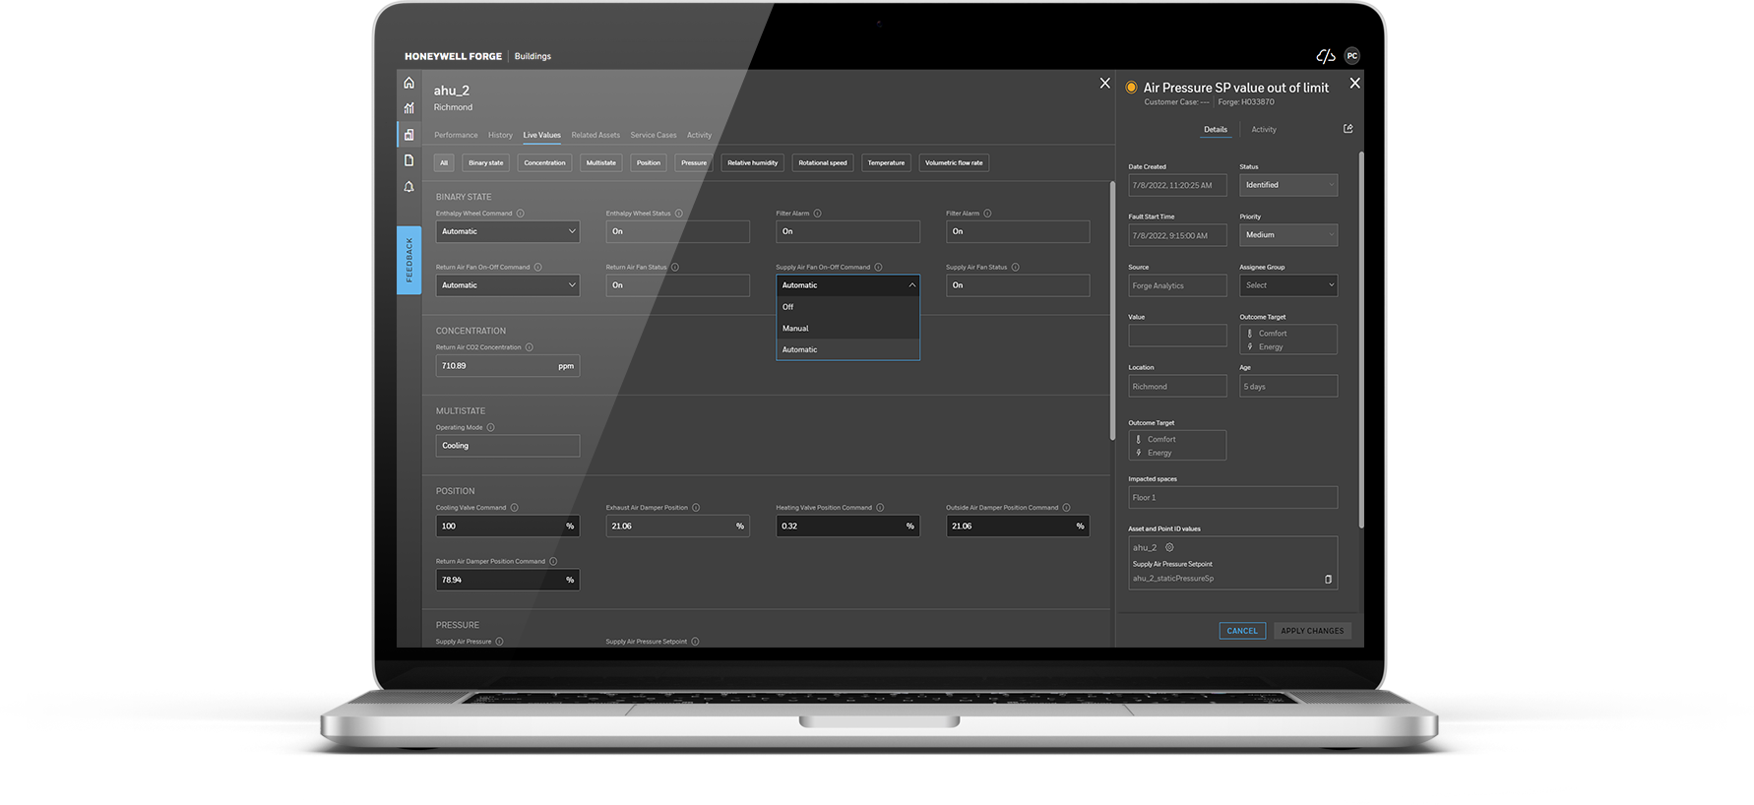
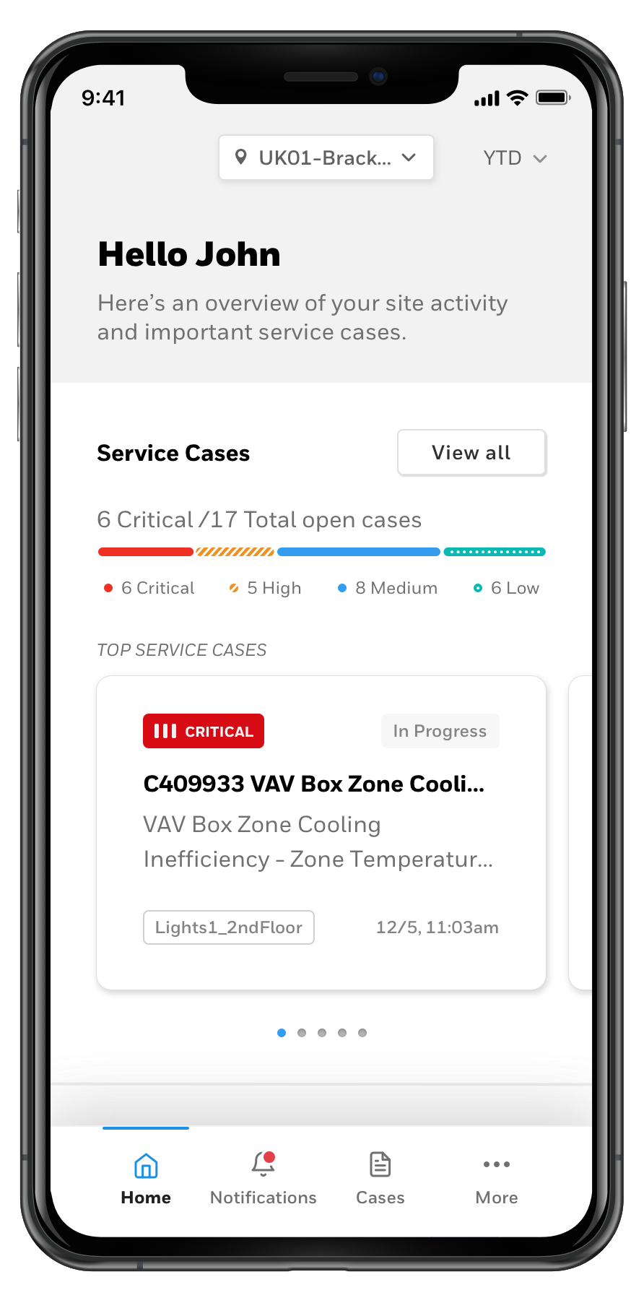
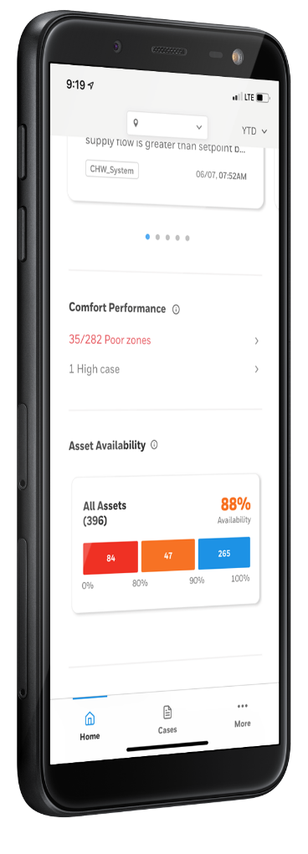
Predictive Maintenance
Include
The Predictive Maintenance App aims to lower the operating and maintenance costs of assets while enhancing equipment uptime, service operational efficiency, and occupant comfort. This application supports the shift from planned and reactive maintenance to on-demand maintenance. Issues are quickly identified by continuous data analysis and can be addressed promptly. Users can remotely monitor real-time values and trends of asset properties and examine issues in related assets to determine root causes. The app also enables remote control of device setpoints and configurations for troubleshooting and allows service cases to be assigned to appropriate teams as required.
Key Features/Benefits
Improved Building Performance – The software identifies necessary repairs, reducing search and diagnosis time. This allows maintenance teams to address issues more efficiently before they impact energy consumption or occupant comfort
Reduction in Site Visits – Remote triage of faults and resolution of site issues minimize the need for technician visits, enhancing planning and reducing field service costs.
Operation Centre – Centralized management capabilities enable a single team to oversee numerous sites, thereby decreasing the cost of managing dispersed property portfolios
Critical Facility Uptime and Enhanced Occupant Experience – Rapid response to occupant requests and system issues through direct resolution or prioritized case handling enhances both occupant comfort and building operations.
Improved Employee Productivity – A unified, simplified user interface across various subsystems (HVAC, security, fire) combined with a knowledge base and machine-learning support reduces training requirements and task completion time.
Early Detection of Asset Maintenance – Unified real-time data collection and analysis via sensors facilitate early identification of asset issues, ultimately reducing downtime and lowering costs.

Slide 33

Include
SustainabiLity +
Honeywell Forge Sustainability + for Buildings is a scalable building controls platform with a suite of applications designed for organizations and entities that need to meet their sustainability goals – reducing energy use and carbon impact. It can help simplify reporting and provide an operating system for the building to help achieve energy reduction targets while adhering to guidelines and regulations.
Carbon and Energy is designed to monitor, control and optimize energy use and carbon footprint. It digitizes the energy consumption data from all utilities and energy meters to capture portfolio’s scope 1 & 2 carbon emissions and improves energy efficiency through autonomous energy conservation measure and dynamic load management
Key Features/Benefits
Live Monitoring: Monitoring live meter data for CO2 emissions, energy, and utilities allows for real-time tracking and management, leading to more informed decision-making and better environmental performance.
Enhanced Monitoring and Control: By managing alarms and alerts, and monitoring various points, building operators can maintain better control over building operations, ensuring systems run efficiently and issues are addressed promptly.
Indoor Air Quality (IAQ) Tracking: Tracking multiple indoor air quality measures and providing a KPI dashboard helps building operators and occupants understand and maintain good IAQ, contributing to a healthier indoor environment.
Non-Intrusive Load Management: Breaking down energy consumption to the equipment level allows for more precise control and optimization, leading to reduced energy waste and lower operational costs.
Optimized Energy-Intensive Assets: Systems like chillers, boilers, fans, water source heat pumps, air-handling units, condensers, plug loads operate more efficiently, reducing overall energy consumption.
Reduced Manual Intervention: Automation and smart controls minimize the need for manual adjustments, leading to more consistent and efficient operation.
Personas
PERSONA | MOTIVATIONS
Chief Sustainability Officer | Manage organizational ESG commitments & concerned about ability to show progress against commitment Measure achieve, and report key ESG KPIs across the portfolio, such as GHG production
Portfolio Manager | Manage organizational building portfolio in a way that enables sustainability goals & efficient operations Every site has a different BMS, and the systems are often not up to date
Energy Manager | Manage efficient operations while meeting utility spend goals Mitigate the impact of rising utility rates
Facility Manager | Ensure facilities operate reliably and efficiently Drive opportunities to increase operational savings while maintaining comfort
FAQ
Q: Does CEM Monitor needs a BMS system?
A: No, CEM Monitor package does not requires a BMS system at site. It extracts data directly thru Utility providers.
Q: Which specific brands of BMS can be integrated to CEM?
A: The solution is BMS agnostic and can integrate with non Honeywell BMS systems thru Bacnet IP /Modbus/Open protocols..
Q: What are the biggest contributors to energy consumption in a building that can be optimized by CEM?
A: HVAC ~35% and Plug load ~13%
Q: Can I override the Carbon emission factors that are defined in the s/w
A: Yes, both Scope1 and 2 emission factors can be overridden.
.

Slide 34

Include – needs simplifying
SINE
Key Features/Benefits
Sine Core – Provides streamlined visitor and contractor sign-in and out process with electronic records. Create registration flows for any type of visitor, get entry documents signed electronically, and personalize check-in kiosks with organizational branding.
Workflows – This optional module adds multi-level automated workflows. Manage different visitor types, collect and verify required documentation before, during, and after site visits - from simple guest access to complex contractor compliance
Companies – Another optional add-on, Companies delivers an end-to-end connection point between a contractor and the company they work for, ensuring full compliance prior to arrival.
Sine Pro mobile app – Provides frequent or returning visitors and contractors a fast and convenient check-in experience, while hosts can approve and receive notifications on the go. The native mobile app also provides roll call functionality to account for people on site, and alert notifications in the event of an emergency.
Sine Lobbies – Simplified multi-tenant management empowers tenants to tailor the solution to their own needs—all in one streamlined experience so visitors can check in to any tenant from a single or multiple Sine kiosks.
Automatic geofence check-in/out - Automates site entry and exit records without manual check-ins, ensuring accurate time-on site metrics.
Real-time integrations with access control systems - Automatically issues and revokes credentials based on status.
Elevator Pitch
FOR Facility and Security managers
WHO NEED To manage safe and secure entry of visitors and contractors
HONEYWELL’S Visitor & Contractor Management
PROVIDES An automated and auditable mechanism to manage and track all phases of visitor and contractor entry
UNLIKE Traditional paper-based systems
WE DO THIS BY Providing real-time dashboards, reports and Integration with access control systems
AS DEMONSTRATED BY over 3,000 active customers
Personas
PERSONA | MOTIVATIONS
Facility Managers | Get their contractors in the building and working quickly, safely and securely Provide a single source of truth for visitor and contractor inductions Digitally issue and manage contractor permits
Security Managers | Transform from paper-based sign in logbooks Gain a clear view of who is in the building and when – across their portfolio. Deny access to bad actors
Compliance Managers | Access to digital records of inductions Quickly confirm adherence to safety policies Automatically restrict access to companies with expired compliance documentation
FAQ
Q: Is Sine offered as a cloud-based or on-premise solution?
A: Sine is a cloud-based solution, reducing cost of infrastructure and ensuring all customers are always running then latest version of software across their portfolio, no matter the size.
Q: Will it integrate with my access control system?
A: Yes, Forge VCM integrates with a variety of access control systems to provide a seamless entry and exit experience for visitors and contractors alike.
Q: Can Sine integrate with other enterprise software?
A: Yes, Sine offers an extensive library of business and productivity tool integrations including Azure AD sync, MS Teams and Outlook, and a host of others to provide a seamless and connected experience.

Slide 35







PARNTER AND CUSTOMER BENEFITS
Include but
Separate into 2 slides please
CUSTOMER BENEFITS
PARTNER BENEFITS
COST TO SERVE
UPTIME
Early identification of issues leading to faster resolution
Reduction in downtime
Reduction in truck rolls and unplanned expenditure
Easy access to Upgrades
Reduce ‘Cost to Serve’ across existing/ new customer site by establishing secure connectivity
Enables remote analysis and fixes, reducing the need for multiple site visits.
Target: 100% Remote Services
COMPLIANCE
Baseline building performance
Digital visibility of assets and performance
Proof of maintenance reports
REVENUE GROWTH
Drive incremental revenue growth through monetization of apps
Growth opportunities for customer identified through obsolescence assessment app
Additional HBOC services
Improved Spot sales
RISK MITIGATION
Cybersecure remote access to site
Cybersecurity monitoring and reporting through Cyber Insights
Cyber risk mitigation through remote cyber ICT services
DIFFERENTIA-TION
Establish offering differentiation for HBS by enabling vertical specific applications,
Offering real-time insights and improved services
End to end offering
ENERGY AND SUSTAINABILITY
Sustainability monitoring, reporting and optimization through Forge Sustainability suite of applications

Slide 36
BACK UP CRAFTED IGNORE PAST THIS SLIDE

Slide 37
CYBER INSIGHTS / WATCH / GOVERNANCE
In complete

Slide 38
Ordering sku
Starter Package
Up to 1,500 total points | Up to 3,000 total points | Up to 5,000 total points | Additional 1,000 points
BMS-RBM-BASE-1500 | BMS-RBM-BASE-3000 | BMS-RBM-BASE-5000 | BMS-RBM-ADD-1000
Digitize Install Base
KPI Dashboard
RBM
Remote
Opportunity & Obsolescence Tool
Connect
Add On Sale
First 600 Analytical Points | Additional 100 Analytical points
BMS-PDM-BASE-500 | BMS-PDM-ADD-100
Connect +
PdM service case mgmt. (Analytical rules)
Remote Digital PPM with compliance reports
OTA upgrade & Asset 360
Maintenance Assist
Add on Sale
CEM Monitor | CEM Optimize
BMS-CEM-BASE-01 BMS-CEM-ADV-10 (any add on) | HFB-ENRG-OPTZ
CEM Monitor
CEM Optimize
Connected Power
Sustainability +
Monetize
Add on Sale
Additional 5 Custom Dashboards + 5 Custom Reports
BMS-IB-ADD-5
Custom Report & Dashboard Builder
Forge Insight &
Dashboard
Builder
Add on Sale
First 25 Sites | Additional 25 Sites
BMS-PM-BASE-25 | BMS-PM-ADD-25
Portfolio view of multiple sites
Forge Portfolio
Manager
Add on Sale
Alarm Mgmt/Site | Emergency Monitoring/Site
Yet to be launched | Yet to be launched
Alarm Management
Emergency Site Monitoring
Reporting Services
Forge HBOC
Services
38

Slide 39
Support
In complete

Slide 40
value pricing | CONNECT PLUS | SERVICE PROVIDER
No
Example – Traditional Service contract $43,875, Labour rates: $90/hr, BMS points: 4,000 and Analysed points: 1400, Connected via EBI Connect
A
B
C
NBA
Do nothing - Traditional Service practices is incapable of generating digital value
Value Created
35% Operational Savings due to Productivity/Labour savings
5% savings on admin hrs like manual reporting, root cause analysis etc
20% incremental Spot work revenue generated due to Opp and Obs app
Value Shared to Service provider is 60%
Value captured by Forge 40%
$2,000
$3,000
$16,524
$9,914
$8775
4
$6,610
5
SHARED
TARGET PRICE
$10,749
3
VALUE
CREATED
CAPTURED
CAPTURED
1
$0
2
6
7
8
Do nothing |Traditional Service
Operational Savings
Spot work Revenue
Intangible benefits (admin benefits, reporting etc)
Costs to switch, or connect
(Install labour)
Maximum Price
Value shared with SI
Target Price
SaaS Price: $5460 based on $4 per point
Next Best Alternative Price
+
Value of offering incremental to Next Best Alternative (2+3-5)
=
Maximum
Price (6)
-
Value
shared (7)
=
Target (8)
Price
Notes:
Spot Work Margin – not accounted now
Incremental spot work of 20% of contract value.
= 16*100

Slide 41
value pricing | CONNECT PLUS | END CUSTOMER
Example – Energy costs = $130,781 $, Admin cost = $16,146 , Asset Cap = $82,990 , BMS points: 4,000 and Analysed points: 1400, Connected via EBI Connect
No
A
B
C
NBA
Do nothing
Value Created
3% Energy avoidance due to energy centric maintenance
5% savings on admin hrs like manual reporting, root cause analysis etc
10% on asset depreciation*
80% reduced risk of Asset downtime avoidance. (WTP is higher depends on specific verticals)
Selling : Consultative and based on incremental quantifiable value from Y2, and other benefits like visibility to portfolio, asset uptime efficiency improvements.
Value Shared to customer is 50%
Value captured by SI 50% (Y1)
$8,299
$5,000
$10,638
$5,300
$800
4
$5,300
5
SHARED
TARGET PRICE
$6,539
3
VALUE
CREATED
CAPTURED
CAPTURED
1
$0
2
6
7
8
Do nothing
Energy Avoidance
Admin
(Custom dashboard, Reports)
Tangible but Hard to Prove – Asset Life Cycle Depreciation cost)
Costs to switch, or connect
(Install labour)
Maximum Price
Value shared with customer
Target Price
Target Max SaaS Price: $5300 ie $3.7 per point
Next Best Alternative Price
+
Value of offering incremental to Next Best Alternative (2+3-5)
=
Maximum
Price (6)
-
Value
shared (7)
=
Target (8)
Price
Notes:
Spot Work Margin – not accounted now
Incremental spot work of 20% of contract value.
= 16*100

Slide 42

GENERATING SURPLUS VALUE | SERVICe PROVIDER
No
Adopting a digital service execution model will set us up for success ultimately reducing op cost for customers
Service Contract of 4K BMS points (~1.4K Forge points) in Canada (e.g. Sick Kids Hospital)
Forge Connect Plus Cost to Service provider is $4 per analysed point.
Value Generators for Service Provider – 35% savings on maintenance labour
Revenue generation – 20% incremental revenue on Spot.
Cost to run service reduced by 12% + Incremental Revenue of $8,775 + 119 hrs of additional service tech capacity to service other sites or spend quality time with customers
VALUE GENERATED
With value capture 40-50% > Target Price= $5625 - $6,500
Notes:
Reduce cost to serve is calculated Maintenance service savings enabled by automated functional check = $114K, BMS point count around 35k =3.3$/ BMS point

Slide 43




BA CONNECTED STRATEGY
No
2024
SECURE CONNECT
2025
SIMPLY CONNECT
100%* NEW SERVICE CONTRACTS CLOUD CONNECTED
100%* UPGRADES TO INCLUDE CLOUD CONNECTIVITY
100%* NEW INSTALLATIONS TO BE CLOUD CONNECTED
SCOPE:
BMS: EBI, N4 *EXCEPTIONS PROCESS FOR CLIENT PROHIBITED SITES

Slide 44


Connected 1st – Service Approach
No
Expertise of our HBOC Remote Services and FSPs
Target:
Every customer with an eligible supervisor will be connected
EBI-600+ or HVAC/Niagara N4 customers
Embedded by default in all new EBI HVAC/N4 installations, upgrades, and new or existing service contracts
Enables access to the specialists of the HBOC Teams and Field Service teams to resolve issues more quickly.
02
01
Standard Connected Service Capability
Proactive value-added apps under a single platform
Forge AI/ML capabilities
New, simplified connector and software capability
More cost-effective than before
More capable and faster to deploy
03
Predictive maintenance, remote services, patch updates, and obsolescence & recommendation insight – all apps in one platform

Slide 45
Roadmap | what is different for HBS?
No
Parameter | Current Status | What is different about Connected Strategy compared to today? | How will we do this?
 |  |  | Connected Strategy Drop 1 | Connected Strategy Drop 2 | Connected Strategy Drop 3
Connectivity | Limited Connectivity to sites through HBOC/Forge | Faster and Easier connection Aggressive targets to connect customer sites New connectivity package provides Simplified IT requirements Packaged Remote Connectivity Additional Asset information | Provide set up for faster and easier connectivity (More details in the next slide TBD) Target: Connectivity options for >10% of install base with existing apps | Target: Expanded (80% of IB) connectivity with apps & services | Target: Expanded connectivity to >95% of the install base
Apps and Services | Multiple Independent Apps Limited Domain Specific Apps | Proactive value-added apps for customers All apps under the same platform | No immediate change to existing apps and services | Significant Monetization with Apps Obsolescence Assessment App Basic Insight Builder ARaaS Self Service PdM Report Builder Opp Assessment | New tiering of apps Specific apps for creating value for partners Remote Commissioning App Portfolio & Alarm Manager for App
Data Collection | Limited Data Collection through manual methods or using Asset Discovery Tool | Extensive knowledge on assets in install base Real- time asset data availability | Follow up with executing Asset Discovery Tool at greater number of connected sites | Real-time asset data updates through Obsolescence Assessment app | Simplified cloud connection
HBOC Services | Basic remote services provided through HBOC | Advanced remote services through HBOC | No immediate change to existing services | Extended HBOC Services Catalogue | Extended HBOC Services Catalogue
Visibility to customer | Limited Self-serve capabilities | Extended capabilities for the customer through Service Provider Portal | No immediate change to existing services | Dashboard capabilities provided through Service Provider Portal based on service contract value | Cockpit view to manage all sites subscriptions

Slide 46
Service Contracts IMPACT - Connectivity
No
Site Classification | Deployment | RBM Added to Contract? | PDM Added to Contract? | CEM Added to Contract? | Charge Customer?
Existing Forge PDM sites deployed | Upgrade Cloud Connector | Yes | Yes | Yes | No
Existing Forge Registered and not deployed | Upgrade Cloud Connector + Asset Modelling | Yes | Yes (only if contract size > 50k) | Yes (only if contract size > 50k) | No
Existing Secure Connect HBOC sites | Install Cloud Connector + Asset Modelling | Yes | Yes (only if contract size > 50k) | Yes (only if contract size > 50k) | No
In flight Forge PDM not deployed | Install Cloud Connector + Asset Modelling | Yes | Yes | Yes | As per PO
In flight Install jobs | Install Cloud Connector + Asset Modelling | Yes | Yes | Yes | Yes, in New Service Contract
Existing Contracts with EBI < 600 upgrades | Install Cloud Connector + Asset Modelling | Yes | Yes | Yes | Yes, in Upgrade
New / Renewals | Install Cloud Connector + Asset Modelling | Yes | Yes | Yes | Yes

Slide 47

Unified APP dashboard
No

Slide 48

What this means for HBS
No
All contracts that are quoted for BMS will have “Connected” costs added
Manually at first; automated in CPQ by Q2
Additions to contract agreement document
New Honeywell T&C’s
New Honeywell Standard Warranty
Exceptions are…
Where not allowed by customer policy (Federal, Government, Data Center)
By regions, public funded works need in country cloud (META, Pacific)
Approved by BA leadership
    Approval & tracking will be manual in Q1, automated through CPQ and SEA
  Fire, Security and Mechanical contracts
Services in first Quarter stay the same, from Q2 we look to offer a new contract

Slide 49






supporting the journey
Resources and key links
Connected 1st Call
Connected Brochure
Technical Training
Field Awareness
Connected World Tour
Sales Training

Slide 50
No
THE ASK:
SALES/P&E | INSTALL | SERVICE
Estimate inclusions of : Cloud connector License costs Basic cyber provisions | Include in project plan, steps for Cloud connectivity HBOC Onboarding Cyber setup | Escalations and renewals to explicitly state cloud connectivity provisions (standard wording in letters)
Include standard connectivity, data and cyber provisions for all BMS Project and Service Contract Offers | Ensure client project meetings cover connectivity provisions and introduce ICT subject matter experts as required | All >R600 sites where no written customer policy prohibiting connectivity to be connected with client agreement
Global T&Cs now cover Projects & Service. Standard connectivity and data provisions covered in T&Cs Where client T&Cs appendix required as part of Warranty and Service contracts | Retrospective connection of all current pipeline jobs with client agreement Warranty period installs Current site installs | Onboard all new connections to HBOC and agree scope of PM, Forge, Asset & Breakfix tasks
Exceptions process will be SEA L5
NOTE: HBOC is included as standard service delivery with above provisions

Slide 51
BA CONNECTED STRATEGY | DROPWISE PLAN
No
Partner SI Strategy
End User Strategy
Drop wise Plan
Value Proposition
Connectivity | Partner Portal | HBOC / Partner Apps
New Data Pipe (HBOC + Data + Assets) – EBI Only | Onboarding module User mgmt. module Org. Mgmt. Module | Current RBM App Current PdM App New Remote Management App Current Insight` builder
New Niagara Sup. & dev. cloud conn Low-cost gateway Forge Remote in all connectivity modes EBI CC enhancement | Basic Subscription Mgmt. Enhanced Subscription management | Obsolescence Assessment App Basic Insight Builder ARaaS Self Service PdM Report Builder Opp Assessment Remote PPM
IQ5 connector RDM capability upgrade for data pipe ~ all systems Alerton Compass Connector |  | Remote Commissioning App Portfolio & Alarm Manager for App
Value Added Apps | Value Added Managed Svs
Asset Reliability as a Service Carbon & Energy Manager Connected Power
 | Existing HBOC Services Catalogue
 | Extended HBOC Services Catalogue
General Availability | Implications
 | Basic Digitization with Maint./ Manager for Direct IB (HBS) ~ 10% of the IB (30% of HBS IB)
 | Basic Digitization for 80% of the available base with Niagara. Significant Monetization with MM & Opp. App.
 | Partner Monetization with Partner Apps. 95%+ of the IB Opens up Alerton Base
Value for HBS/ Partners | Value for End Customer
DROP#1 -
1FEB25
~+20% Productivity
~+5% Critical Asset Life (TBD)
~+5% Monetization
~+10% Uptime (TBD)
Drop 1: Connectivity options for >10% of install base with existing apps
DROP#2 -
1APR25
~+5% Energy Savings
~+30% Productivity
~+12% Monetization
~+5% Critical Asset Life (TBD)
~+10% Uptime (TBD)
Drop 2: Expanded (80% of IB) connectivity with apps & services
DROP#3 -
1Jul25
~+50% Productivity
~+10% Energy Saving
~+20% Monetization
~+5% Critical Asset Life (TBD)
~+25% Uptime (TBD)
Drop 3: 95%+ IB Coverage with extended Partner & SaaS Apps
API Marketplace for Partner Portal & Low-Code/No-Code Integration Framework for Partner Apps - Delivery Plan & Timeline yet to be finalized

Slide 52
No
https://honeywellprod.sharepoint.com/:p:/r/teams/NPIShowcase/_layouts/15/Doc.aspx?sourcedoc=%7B43172ABB-9122-4E0D-AAE0-CD07834DE2B4%7D&file=HBS-connected-strategy.pptx&action=edit&mobileredirect=true

Slide 53













Done, but the graphics does not bring the message across to me, the right image looks more ”chaotic” to me but the slide like that is needed, before – after
It’s time to reimagine
what buildings can do
software, service, smart edge products
THEN: DISCONNECTED
Siloed systems and data
Custom-engineered connectivity
On premise only
In-house facility team
NOW: CONNECTED
Integrated systems for insights
Embedded connectivity by default
Cloud and mobile
Outsourced and remotely managed FM

Slide 54
How ArE We DOING IT
Slide 4 does cover all
1
FASTER & FLEXIBLE ordering
2
STREAMLINED CONNECTIVITY
3
SELF SERVICE PARTNER PORTAL
4
SPECIALIZED APPS
Mybuildings.honeywell.com for instant ordering
Order Hardware & SW subscription SKUs together
One cloud connection pipe - multiple form factors
Remote management
More than just telemetry & alarms
Full Self-Service capabilities
Cockpit view to manage all sites subscriptions
Automatic data contextualisation
New tiering of apps
Specific apps for creating value for partners
Improved from
Manual Ordering Process
Takes up to 7 days
Limitations in modifications
Complex commissioning
Limited data collection
Limited self serve capabilities
Partial User & Subscription mgmt
Multiple Independent Apps
Limited Domain Specific Apps
No Partner Value Creation Model
CREATING VALUE FOR PARTNERS & END USERS

Slide 55
BA connected platform: PRODUCT EXECUTION STRATEGY
One platform from BA built on Forge 2.0
1
Channel install base monetization through remote management & partner portal
2
PdM
End user monetization with value added applications and after market services
3

Slide 56
TIERED Software PACKAGES
Starter Package
Up to 500 total points | Up to 1,500 total points | Up to 3,000 total points | Up to 5,000 total points | Additional 1,000 points
BMS-RBM-BASE-500 | BMS-RBM-BASE-1500 | BMS-RBM-BASE-3000 | BMS-RBM-BASE-5000 | BMS-RBM-ADD-1000
$499 | $699 | $899 | $1199 | $199
Digitize Install Base
Connect
KPI Dashboard
RBM
Remote
Opportunity & Obsolescence Tool
Add On Sale
First 600 Analytical Points | Additional 100 Analytical points
BMS-PDM-BASE-500 | BMS-PDM-ADD-100
$999 | $199
Connect +
PdM service case mgmt. (Analytical rules)
Remote Digital PPM with compliance reports
OTA upgrade & Asset 360
Maintenance Assist
Monetize
Add on Sale
Additional 5 Custom Dashboards + 5 Custom Reports
BMS-IB-ADD-5
$2499
Custom Report & Dashboard Builder
Forge Insight &
Dashboard
Builder

