Slide 1

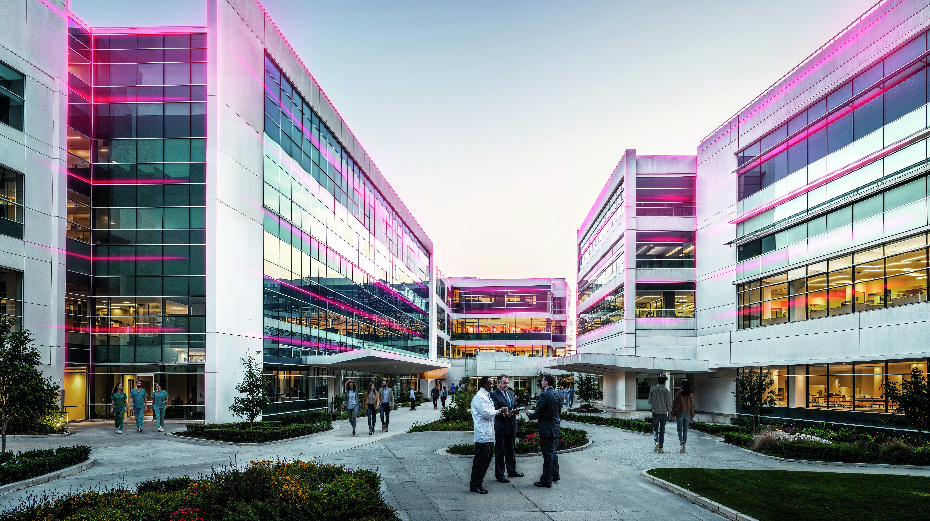


LET’S CONNECT
AND ACHIEVE THE OUTCOMES THAT MATTER MOST
June 27, 2025
VAIBHAV AGARWAL
  Global Connected Solutions – OFFERING LEADER

Slide 2
agenda
BACS- Offering Overview: Explain the strategy
What’s Changed?
Technical Architecture
Value Proposition: Partners.
Value Proposition: Customers & End Users
Ordering, Package and Pricing.
Partner Benefits
Customer Benefits
Target Customer & Target Verticals

Slide 3

BUILDING OWNERS and OPERATORS
OPERATIONAL UPTIME
ENERGY EFFICIENCY
& RESILIENCE
priorities for next 12 months
64%
high priority for reducing asset downtime.
69%
high priority for achieving net-zero targets
Honeywell commissioned Verdantix to interview 100 building owners
and operators to gain insights into near-term priorities. Geographical representation:
United States
England
Germany
United Arab Emirates
Turkey
Singapore
India
Malaysia
Australia
Industry coverage includes Healthcare, Pharmaceuticals, Manufacturing, Commercial Real Estate and Facility Management Services.
COMPLIANCE WITH REGULATIONS
RISK
MITIGATION
67%
being compliant with the increasingly complex government and industry regulations.
76%
recognize value of asset failure prediction software
Information Technology Information Consulting, Security, Data Breaches Top Cause of Downtime in 2022, [Accessed May 5, 2023].
Municipalities and governing bodies are increasing new cyber and ESG guidelines: New York City Local Law 97 requires 40% emissions reduction for the city’s largest buildings by 2030
Deloitte Insights, Making Maintenance Smarter, Predictive Maintenance and the Digital Supply Network, 7 May 2017, [Accessed May 5, 2023].
Notes:
Operational efficiency
64% high priority for reducing asset downtime. One hour of downtime can cost more than $1M for mid-sized and large companies¹
Compliance with regulations
67% being compliant with the increasingly complex government and industry regulations. Example: New York City Local Law 97 requires 40% emissions reduction for the city’s largest buildings by 2030²
Energy efficiency & resiliency
69% high priority for achieving net-zero targets focusing on energy management for operations, sustainability and carbon management
Risk Mitigation
76% recognize value of asset failure prediction software as inability to forecast equipment failures takes a high toll as unplanned downtime costs
an estimated $50BN pa³

Slide 4

Partner priorities
REDUCE COST TO SERVE
Cost of operations are high, looking for can new offerings yield a positive ROI.
Growing service and project business
Increasing margins
Delivering maximum value to customers
Winning and retaining customers
Solve for digital workforce needs
ADDRESS SKILL LABOR SHORTAGES
Adapt my business model to the current job market.
INCREMENTAL GROWTH
Offer additional services, expand my business and shorten sales acquisition times.
DIFFERENTIATE
Differentiate my service to retain and win new customers.
Notes:
For system integrators and service providers, digital services are transforming business operations. The key opportunities and challenges include:
Growing service and project business
Increasing margins
Delivering maximum value to customers
Winning and retaining customers
Solve for digital workforce needs
Reduce cost to serve
The value derived from implementing any new software service must surpass its associated cost to serve. It is imperative that these services yield a positive return on investment (ROI) to justify their adoption.
2. Skilled labour shortages
I must adapt my business model to the current job market, enable my workforce with AI driven digital tools, generate capacity to manage 2x contracts
3. Differentiation
need to differentiate my service to retain and win new customers and position my business against the cost savings initiatives for
‘standard’ work.

Slide 5
learnings
1
ORDERING
2
CONNECTIVITY
Manual Ordering Process takes up to 7 days causing frustration
Limitations in modifications of ongoing subscription making it a manual request
Frequent issues with first-time success lead to frustration among engineers.
The complicated commissioning process necessitates a more skilled engineer.
In some cases, cost of gateways is a big issue
3
SELF SERVICE
4
APPS
Limited self-serve capabilities
Partial User & Subscription management
Multiple Independent Apps
Limited Domain Specific Apps
No Partner Value Creation Model
Notes:
For system integrators and service providers, digital services are transforming business operations. The key opportunities and challenges include:
Growing service and project business
Increasing margins
Delivering maximum value to customers
Winning and retaining customers
Solve for digital workforce needs
Reduce cost to serve
The value derived from implementing any new software service must surpass its associated cost to serve. It is imperative that these services yield a positive return on investment (ROI) to justify their adoption.
2. Skilled labour shortages
I must adapt my business model to the current job market, enable my workforce with AI driven digital tools, generate capacity to manage 2x contracts
3. Differentiation
need to differentiate my service to retain and win new customers and position my business against the cost savings initiatives for
‘standard’ work.

Slide 6
What’s Changed: LAUNCHING OUR HOLISTIC APPROACH
FRICTIONLESS CONNECTIVITY
DIGITAL SERVICES & PORTAL
100%
SELF SERVICE
SOFTWARE APPLICATIONS & MANAGED SERVICES
From days to hours
Cybersecure
No reprogramming in
the field
Partner Portal
Application packages tailored to customer segment needs
100% self serve
on-boarding, user management & cockpit
view of all sites
New tiering of packaged software applications, managed services
aligned to outcomes
Notes:
For system integrators and service providers, digital services are transforming business operations. The key opportunities and challenges include:
Growing service and project business
Increasing margins
Delivering maximum value to customers
Winning and retaining customers
Solve for digital workforce needs
Reduce cost to serve
The value derived from implementing any new software service must surpass its associated cost to serve. It is imperative that these services yield a positive return on investment (ROI) to justify their adoption.
2. Skilled labour shortages
I must adapt my business model to the current job market, enable my workforce with AI driven digital tools, generate capacity to manage 2x contracts
3. Differentiation
need to differentiate my service to retain and win new customers and position my business against the cost savings initiatives for
‘standard’ work.

Slide 7
transform your service offering while addressing pressing challenges
transform service offering while addressing pressing challenges
FRICTIONLESS CONNECTIVITY
DIGITAL SERVICES & PORTAL
100%
SELF SERVICE
SOFTWARE APPLICATIONS & MANAGED SERVICES
REDUCE COST TO SERVE
ADDRESS LABOUR SHORTAGES
INCREMENTAL GROWTH
DIFFERENTIATE
GROW!
From days to hours
Cybersecure
No reprogramming in
the field
Partner Portal
Application packages tailored to customer segment needs
100% self serve
on-boarding, user management & cockpit
view of all sites
New tiering of packaged software applications, managed services
aligned to outcomes
Notes:
For system integrators and service providers, digital services are transforming business operations. The key opportunities and challenges include:
Growing service and project business
Increasing margins
Delivering maximum value to customers
Winning and retaining customers
Solve for digital workforce needs
Reduce cost to serve
The value derived from implementing any new software service must surpass its associated cost to serve. It is imperative that these services yield a positive return on investment (ROI) to justify their adoption.
2. Skilled labour shortages
I must adapt my business model to the current job market, enable my workforce with AI driven digital tools, generate capacity to manage 2x contracts
3. Differentiation
need to differentiate my service to retain and win new customers and position my business against the cost savings initiatives for
‘standard’ work.

Slide 8






TECHNICAL ARCHITECTURE
TECHNICAL ARCHITECTURE
Partner Applications
CONNECT PACKAGE
KPI Dashboard
Remote Building Manager
Remote
Opportunity & Obsolescence Tool
CONNECT + PACKAGE
PdM service case mgmt (analytical rules)
Remote Digital PPM with compliance reports
OTA upgrade & Asset 360
Maintenance Assist
SUSTAINABILITY APPS
CEM Monitor
CEM Optimize
Connected Power
APPLICATIONS
Partner / HBOC
PARTNER MANAGEMENT PORTAL
Integrated into BA Ecommerce
CLOUD ARCHITECTURE
REMOTE ACCESS
CONNECTIVITY
CONNECTIVITY
OVER THE AIR (OTA) UPDATES
(COMING SOON)
GATEWAY
Honeywell Forge Gateway,
Honeywell Forge Niagara Connect
SUPERVISOR
EBI, Honeywell Niagara,
Alerton Compass, Tridium (Niagara)
PLANT CONTROLLERS
Honeywell, Alerton,
SBC, Trend
IoT DEVICES / FIELD DEVICES
Thermostats,
Connected Power Hub
EXISTING ON-PREMISE INFRUSTRUCTURE
Notes:
For system integrators and service providers, digital services are transforming business operations. The key opportunities and challenges include:
Growing service and project business
Increasing margins
Delivering maximum value to customers
Winning and retaining customers
Solve for digital workforce needs
Reduce cost to serve
The value derived from implementing any new software service must surpass its associated cost to serve. It is imperative that these services yield a positive return on investment (ROI) to justify their adoption.
2. Skilled labour shortages
I must adapt my business model to the current job market, enable my workforce with AI driven digital tools, generate capacity to manage 2x contracts
3. Differentiation
need to differentiate my service to retain and win new customers and position my business against the cost savings initiatives for
‘standard’ work.

Slide 9
Customer journey
01
02
03
04
ORDERING
Order SKUs on BA ecommerce portal
Order acknowledgement received
CONNECTING
Subscription available on Partner Portal
Register Gateway to Cloud
ONBOARDING
Create site & users attach to available subscription
Automatic AI Based Contextualisation starts
Fine tuning with manual contextualization available
APPS
Associate to subscribed apps
Access your apps!
SELF-SERVICE CUSTOMER JOURNEY
Notes:
What you see on the screen is an illustration on how easy it is for customers to transact and onboard remote building manager.
All starts with customer placing order for the subscription of remote building manager. While customers can place orders the traditional way, they can also use the HBT ecommerce platform to select the part codes and place the order. Once the order is processed customers get an email confirmation.
As mentioned before the self service admin portal allows our channel partners to create sites and manage subscriptions and users. Once they log in to the admin portal they can see the remote building manager subscription they have purchased which is available to be attached to new sites. They can then go ahead and create the site and attach the relevant subscription to it.
I now want to show you a how the gateway is commissioned using the onboarding wizard.
What you get at the end is the access to the remote building manager application.
I will now give you quick demonstration of the remote building manager application.

Slide 10
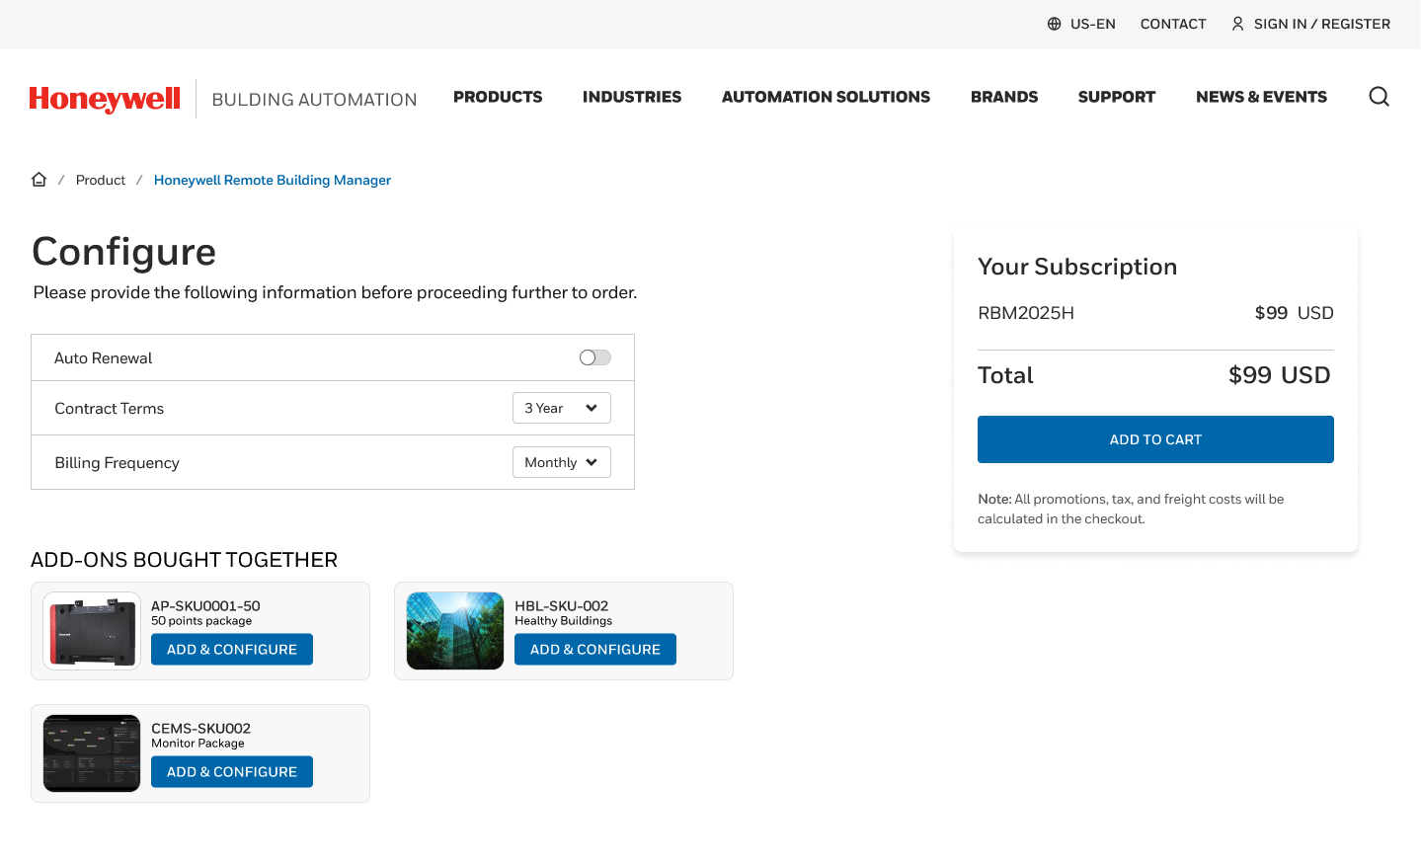
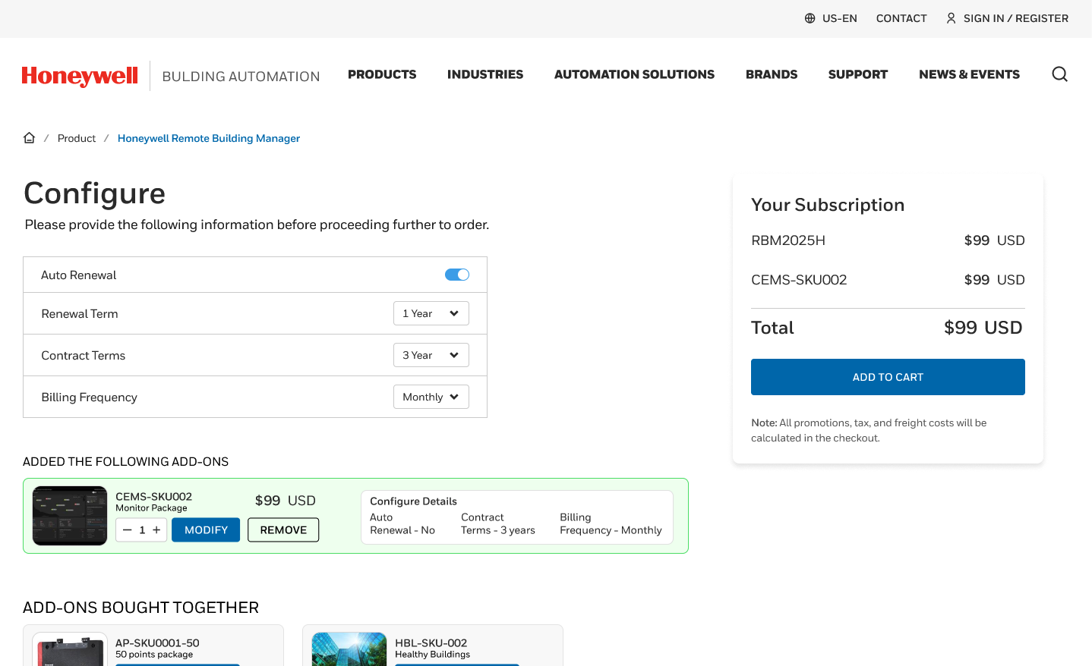
ordering
1
  Via BA Ecommerce Portal mybuildings.honeywell.com
1
improvements
BA Ecommerce site for instant ordering No Excel sheets/ manual process for Ordering. Complete ordering in minutes from current 7 days.
Order Hardware & SW subscription SKUs together- Flexible ordering system to mix and match appropriate SKUs
Single Sign-On – Single Sign-On between eCommerce Portal and Partner Portal
1
2
2

Slide 11



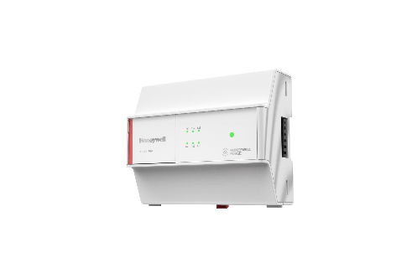
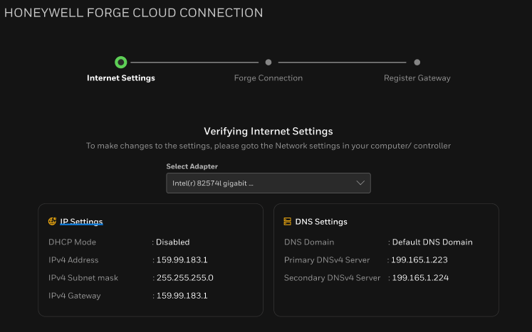
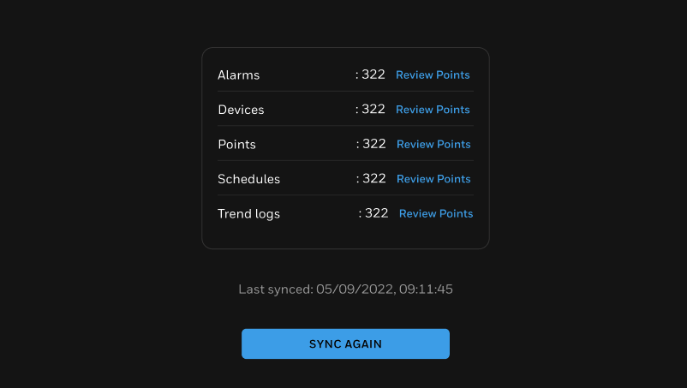
connectivity
2
GATEWAY OPTIONS
GENERAL improvements
One cloud connection pipe - multiple form factors
Remote management – Remote connectivity to gateway, powered by Niagara Remote
More than just telemetry & alarms – Now captures device information as well
No Licensing requirements onsite – Automated licensing for Niagara devices,
1
SOFTWARE based GATEWAYS
Niagara supervisors
EBI
Alerton Compass Coming soon
Supports up to 75K points
2
HARDWARE GATEWAYs
Simplified workflow
Forge gateway (NEW!)
Setup Internet Settings
Verify Internet Connection
Collect
BMS Data
Sync with Cloud
Supports BACnet & MODBUS
Non Niagara device
Webserver based commissioning
Up to 3000 points Supported
Niagara Devices
Optimizer & JACE 9000
Up to 5k Points supported
IQ5
In-built cloud connectivity Coming soon
*Screenshots showcase Niagara based GW Workflows

Slide 12
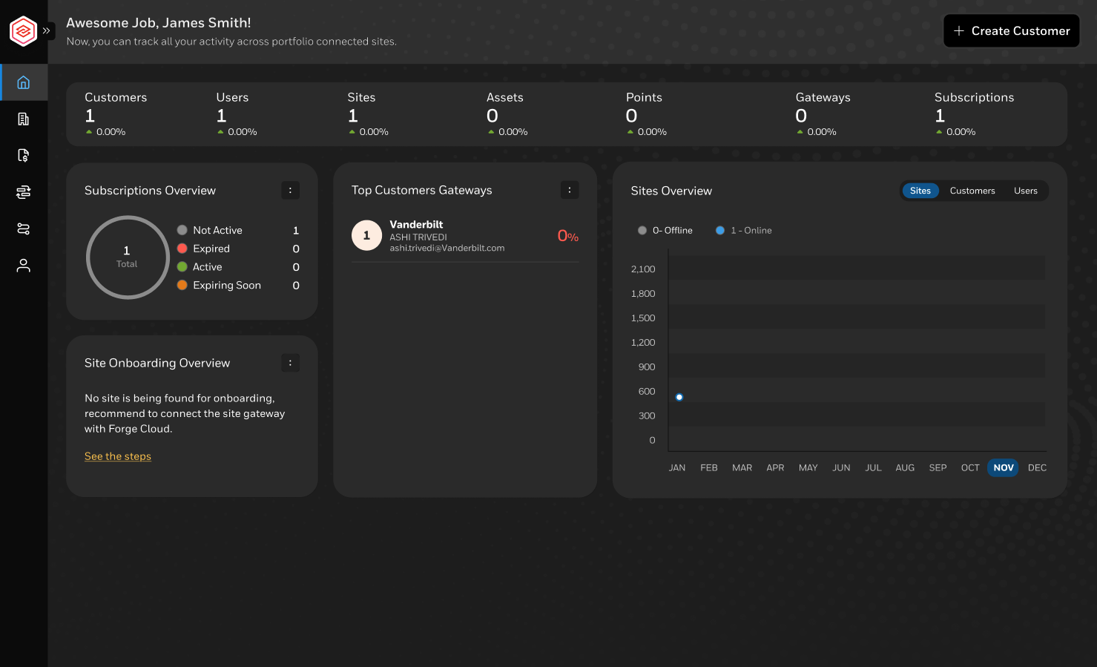
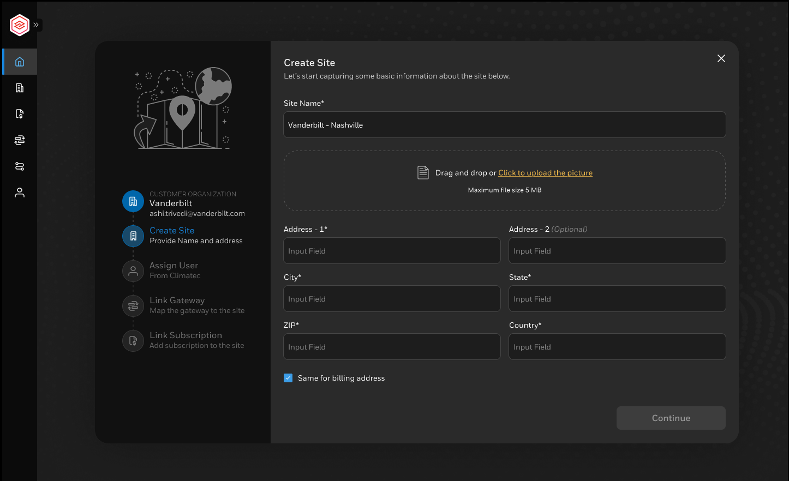
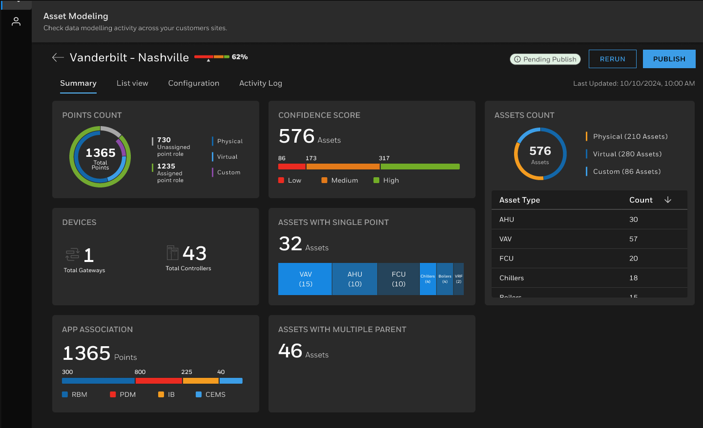
Onboarding – partner portal
3
01
02
03
Cockpit view for partners to look
at overall portfolio of sites
  Online/ Offline sites
  Subscription status & renewals
  Trends
Remote connectivity with gateway on site.
Org and Site Onboarding via intuitive wizard. No more Excel sheets!
Ability to edit hierarchy
New Gateway Management Page with ability to view controller information including model and firmware versions
AI based automatic asset modelling
on cloud.
Allows for faster accurate results.
No more modelling on site!
Tool allows :
  Track status of automatic contextualisation
  Manually edit & fine tune model

Slide 13

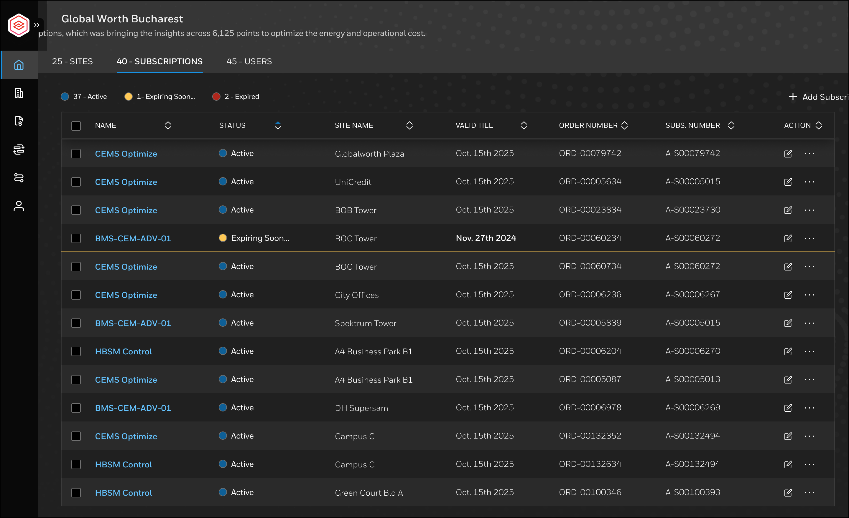
Connect package
REMOTE BUILDING MANAGER
Cloud supervisor for remote monitoring & control
Set point changes, alarms, schedules & trends
ASSET LIFECYCLE ASSESSMENT
Dashboard to highlight connected device list and highlight obsolescence. Streamlines the lifecycle management process.
OPPORTUNITY ASSESSMENT
Identifies maintenance savings opportunities and finds energy savings potential through operational improvements
KPI DASHBOARD
Dashboard that gives a building performance summary view
Notes:
Remote Building Manager - Cloud supervisor enabling building owners to monitoring & control equipment, manage energy, remotely.
Obsolescence assessment - Streamline the lifecycle management process for your building's controls infrastructure, thereby mitigating the risk of failures and enhancing security.
Opportunity Assessment - Identifies maintenance savings opportunities and finds energy savings potential through operational improvements.

Slide 14
Connect ⁺ package
PREDICTIVE MAINTENANCE
Lower operating and maintenance costs of assets while enhancing equipment uptime, service operational efficiency, and occupant comfort
REMOTE PREVENTIVE MAINT.
Remote functional tests as part of planned maintenance, along with detailed service reports
INSIGHT & REPORT BUILDER
Tool to create custom dashboards and gain insights from various data sources easel
Notes:
Remote Building Manager - Cloud supervisor enabling building owners to monitoring & control equipment, manage energy, remotely.
Obsolescence assessment - Streamline the lifecycle management process for your building's controls infrastructure, thereby mitigating the risk of failures and enhancing security.
Opportunity Assessment - Identifies maintenance savings opportunities and finds energy savings potential through operational improvements.

Slide 15
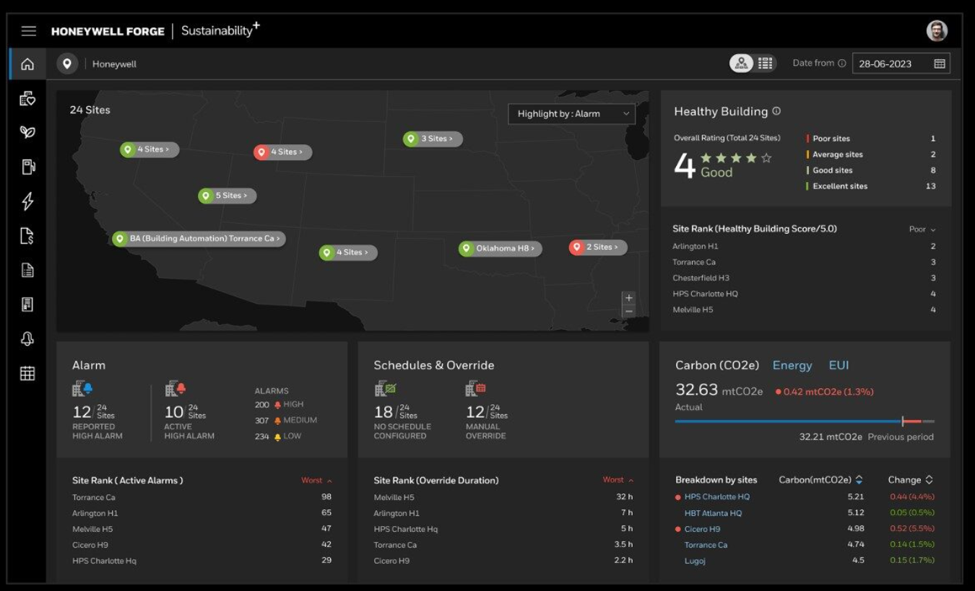
END USER applications & services
Carbon & Energy Monitor
Designed to maintain occupant comfort and reducing the environmental impact of buildings with the aim of improving carbon-reduction goals.
Connected Power
Centralised control over a buildings plug in energy use, with in build temperature monitoring and override capability.
Managed Services
Access Honeywell Building Operations Centre’s (HBOC) managed services for alarm management, remote triage, Remote Preventive Maintenance
Carbon & Energy Optimize (coming)
Applies advanced controls capabilities, artificial intelligence (AI) and machine learning (ML) algorithms to optimize energy intensive assets.
Notes:
Carbon & Energy Management
Monitor Package
Carbon & Energy Management Monitor Package is an application that's ready now to help customers address two pressing, yet often conflicting objectives: maintain occupant comfort and reducing the environmental impact of buildings with the aim of improving carbon-reduction goals.
Connected Power
Our Honeywell Building Operations teams offer remote functional tests as part of planned maintenance, based on SFG 20 service plans. Detailed service reports are generated, including necessary repair, replacement, and performance improvement plans
Carbon & Energy Management Optimize Package (coming soon)
Carbon & Energy Management Monitor Package The scalable, system-agnostic platform uses advanced controls capabilities use artificial intelligence (AI) and machine learning (ML) algorithms to create a baseline of energy consumption and carbon emissions across building assets and can help monitor, control and optimize those assets.

Slide 16
DEMO SESSION
Honeywell Internal

Slide 17
MARKETING
SUPPORT
June 27, 2025

Slide 18
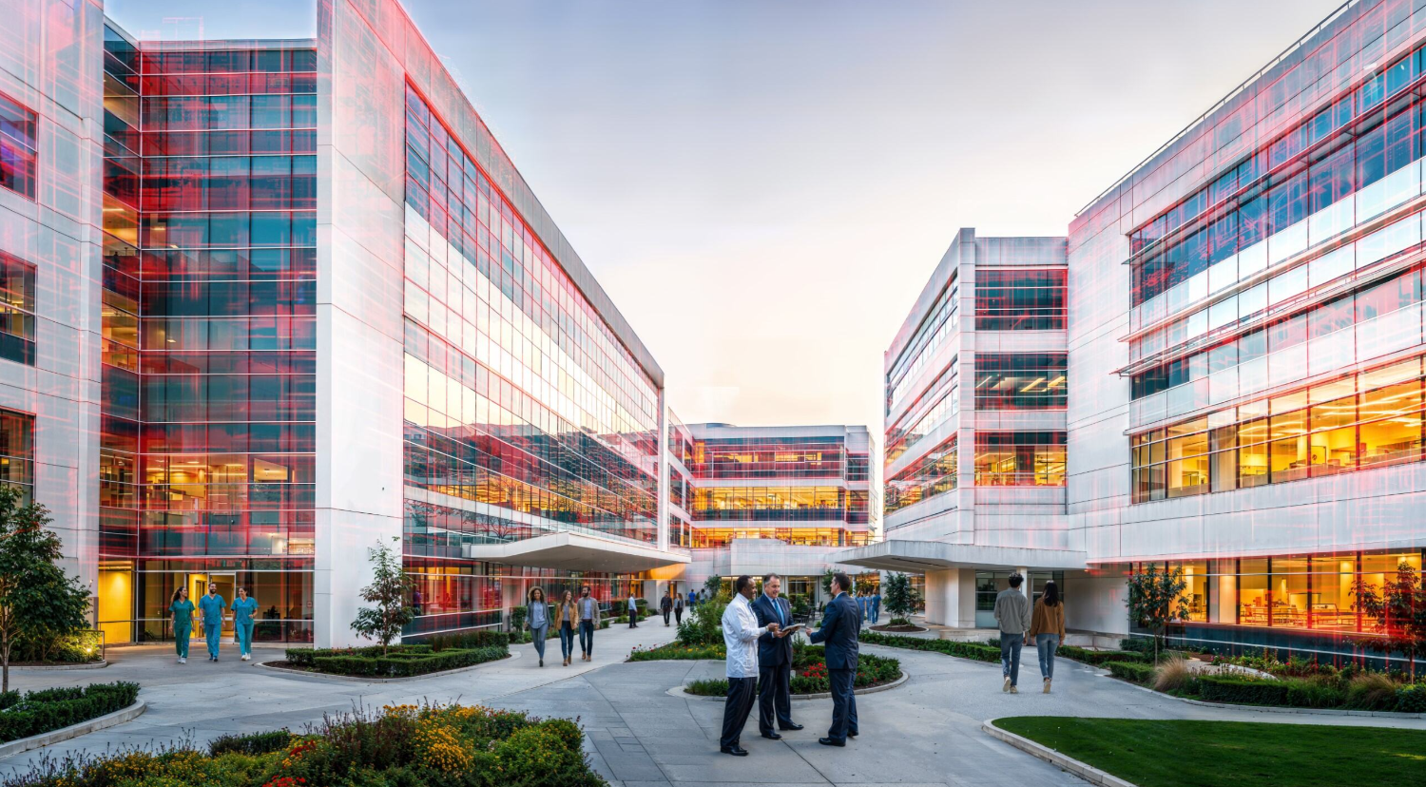

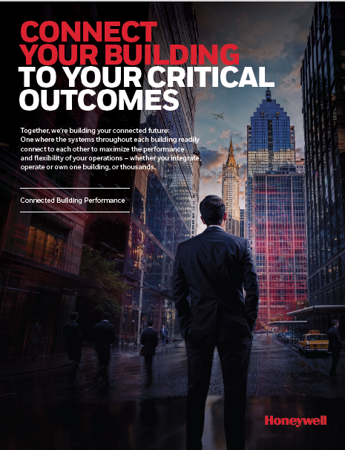
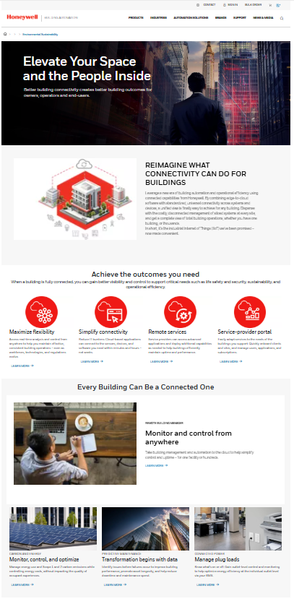

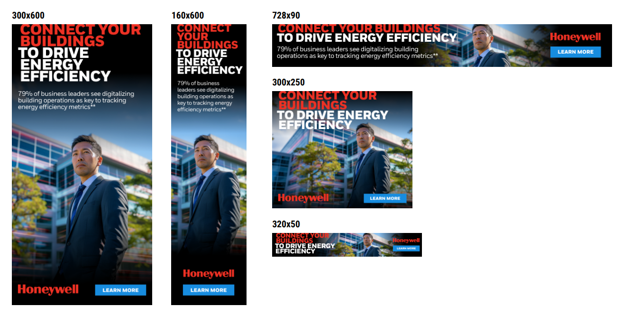
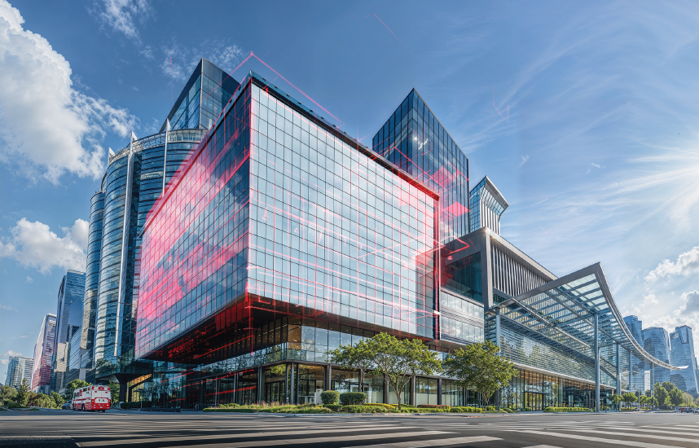
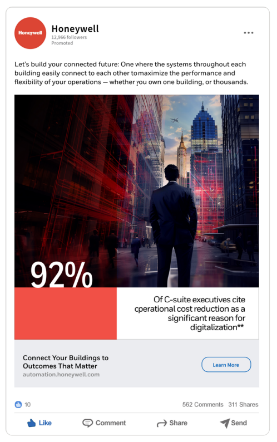
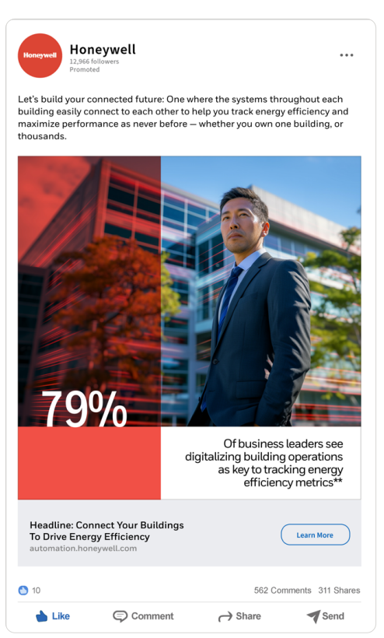
CONNECTED IDENTITY
GENERAL CONNECTED IMAGERY
BMS LANDING PAGE
MARKETING CONTENT
‘BUZZ’ OF CONNECTIVITY CONSISTANT IDENTITY

Slide 19
Connected strategy bms LAUNCH material
SALES ENABLEMENT
DEMAND GENERATION
CREATED
New Connected Brand Identify
End User First Call
End User Connected Strategy Brochure
Partner First Call Deck
Battlecard
Website - BA and BMS Landing pages
Service and End User Application Sell sheets – final edits
Updated - CEM First Call Deck
Updated - RBM First Call Deck
New - PDM First Call Deck
New - Insight Builder Deck
Case Studies – existing global examples
CREATED
New Connected Brand Identify
New Connected Events concept (stand, lightbox, banner)
Email Nurture Connectivity Campaign
Connectivity - Social/SEM awareness assets
Connectivity - Social/SEM awareness and nurture campaign
Connectivity E-Book with feeders 1 pager
Energy Efficiency E-Book with 1 pager
Industry Insights Into Connectivity To Elevate Building Performance
Connectivity - Thought leadership video (+ 20 sec social) – final edits
IN PROGRESS
Partner Engagement Regional Webinar – Late April
Connected Strategy Promotional video (90 sec, plus 20 sec social)
Connectivity - Blog
Connectivity Journey Guide - How To Connect with Honeywell – Guide
Ai partner training video platform (Synthesia) – customisable by language, market, partner (in dev.)
End User Regional Thought leader Panel Webinar Series
IN PROGRESS
Main promotional video
Case Studies - NHS Property Services (UK)
Full BMS Connected Web EcoSystem - SEO, UX
Updates - RBM Brochure
Updates - HBOC remote services brochure
NPI in and Box (Core assets, plus FAQs, Comp. Battlecard, pricing, social assets etc.)
Vidyard Hub video library for training and campaign video content (in dev.)

Slide 20

Value across the board
VALUE FOR YOU
Drives value for your customers giving you greater share of wallet
Software aids hardware pull through sales
Differentiated offerings with SaaS solutions improve winability
Your M4.2 target contributor ~ 20% SIP
VALUE FOR PARTNERS
Cost to Serve – Reduce cost to serve positively impacting profitability
Revenue growth – with recurring revenue from SaaS offerings
Differentiation – create long term relationships with end users
VALUE FOR END USERS
Uptime – identify issues faster to improve uptime
Risk Mitigation – identify obsolescence risk earlier
Strategic Objectives – specific apps like CEM allow end users to meet strategic goals
Compliance - Specific reporting and dashboards allow better compliance
HONEYWELL
FORGE
DRIVING POSITIVE OUTCOMES FOR ALL

Slide 21
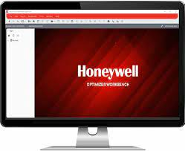
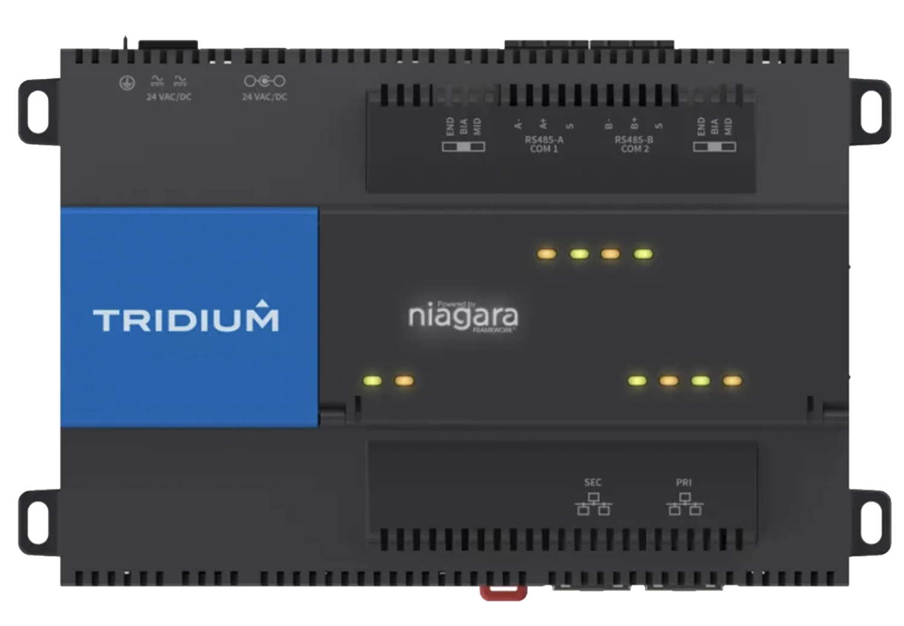
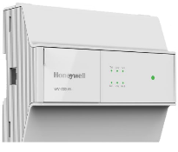
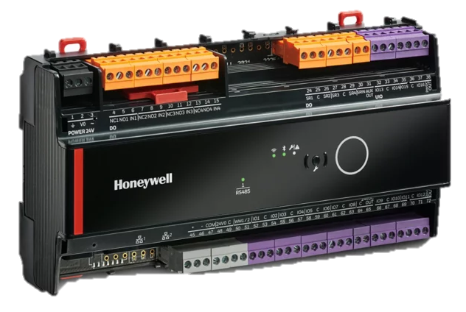

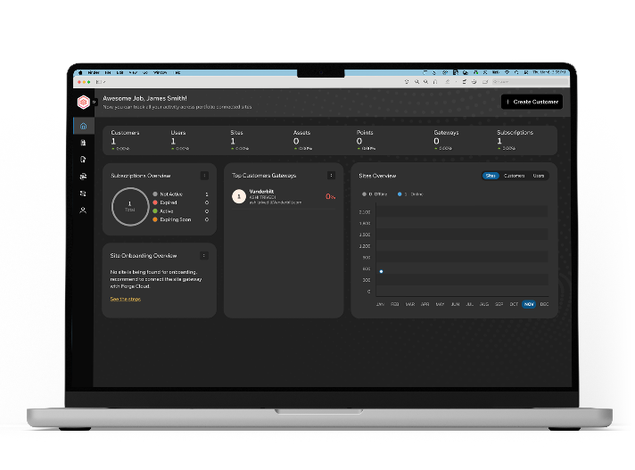
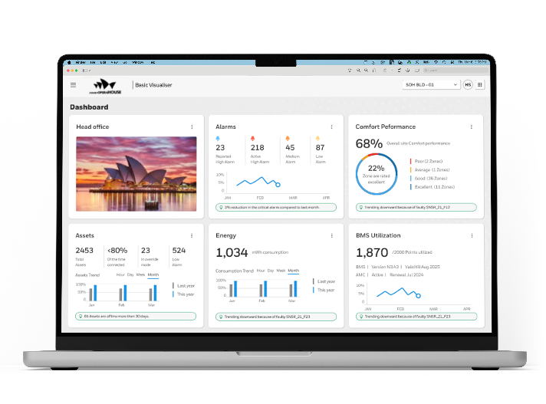
Our Services, expanding your services…
INCREASED CONNECTIVITY OPTIONS
COMING APRIL 2025
OPTIMIZER
JACE 9000
FORGE GATEWAY
IQ VISION
OPTIMIZER
ADVANCED
New Forge Gateway | Simplified IT Config | Remote Connectivity | Access to Device Information | Automatic Niagara Cloud Driver Licensing
YOUR PARTNER PORTAL
For automatic modelling of site and for everyday management of software subscriptions and users
Features: org & site wizard | cockpit view | AI based asset modelling | gateway mgt
APPLICATIONS
NEW: KPI Dashboard | Opportunity Assessment | Asset Lifecycle Assessment | Insight Builder | Remote Preventive Maintenance
EXISTING: Remote Building Manager | Predictive Maintenance | Carbon & Energy Management
Notes:
New Forge Gateway – Gateway supporting BACnet and Modbus protocols for up to 3000 points
Simplified onboarding wizard – new simple UI for connecting sites to cloud
Simplified IT Config – Connection to Forge now requires only 3 URLs whitelisted and 1 Port
Remote Connectivity – Get remote connection to station by default powered by Niagara Remote
Not just telemetry data – New cloud connection now enables to access BMS Controller config information as well
Niagara Cloud Driver Licensing – Automatic licensing of Niagara cloud driver
YOUR PARTNER PORTAL
Org & site Wizard – Creation of Org, Site and users via intuitive wizard with ability to edit hierarchy. No more Excel sheets!
Cockpit view – Service providers now have the visibility to site connectivity, subscription statuses etc for all connected sites.
AI based Asset Modelling – Cloud based Automatic asset modelling with AI/ ML algorithm with the open to add manual inputs.
Gateway Management – New section to view gateways and connected devices along with option to remotely connect to gateway
2 Step workflow - Distributors selling to contractors
NEW APPLICATIONS
KPI Dashboard – Building performance KPIs to
Opportunity Assessment – highlight opportunity for energy savings and asset lifecycle improvement
Obsolescence Assessment – Manage your customer’s risks by identifying obsolete devices
Insight Builder – Create custom dashboards and reports to help your customers’ operations
Remote PPM – Execute PPMs remotely and identify equipment that needs servicing
EXISTING APPLICATIONS
Remote Building Manager | Predictive Maintenance | Carbon & Energy Management

Slide 22
TIERED Software PACKAGES
PACKAGE | TYPE | APPLICATIONS | SKUs | DESCRIPTIONS
Remote Building Manager | Base Connectivity | Remote Building Supervisor KPI Dashboards Opportunity Assessment Asset Lifecycle Assessment | BMS-RBM-BASE-500 | Base connectivity of up to 500 points
 |  |  | BMS-RBM-BASE-1500 | Base connectivity of up to 1500 points
 |  |  | BMS-RBM-BASE-3000 | Base connectivity of up to 3000 points
 |  |  | BMS-RBM-BASE-5000 | Base connectivity of up to 5000 points
 |  |  | BMS-RBM-ADD-1000 | Add-on connectivity of up to 1000 points
Predictive Maintenance | Add-on Application | Analytical rules Remote Digital PPM with compliance reports Service Case Management Maintenance Assist* Asset Health & Operational Risk Assessment* Asset Reliability* | BMS-PDM-BASE-500 | Base package of up to 500 points
 |  |  | BMS-PDM-BASE-1000 | Base package of up to 1000 points
 |  |  | BMS-PDM-BASE-2000 | Base package of up to 2000 points
 |  |  | BMS-PDM-ADD-100 | Add-on package of up to 100 points
Sustainability | Add-on Application | Carbon & Energy Management - Monitor Carbon & Energy Management - Optimize* Connected Power (Limited country availability) | BMS-CEM-BASE-01 | Base package base – up to 5 meters
 |  |  | BMS-CEM-ADV-01 | Additional 1 meter
 |  |  | BMS-CEM-ADV-10 | Additional 10 meters
 |  |  | BMS-CEM-ADV-25 | Additional 25 meters
 |  |  | CEM-CPWR25 | Base package up to 25 sockets (50 outlets)
 |  |  | CEM-CPWR50 | Base package up to 50 sockets (100 outlets
 |  |  | CEM-CPWR100 | Base package up to 100 sockets (200 outlets
 |  |  | CEM-CPWRADD5 | Additional up to 5 sockets (10 outlets)
Insight Builder | Add-on Application | Custom Report & Dashboard Builder Product library with predefined templates* | BMS-IB-ADD-5 | Additional 5 dashboards & reports
Portfolio Manager | Add-on Application | Portfolio view of multiple sites*
Honeywell Building Operation Centre (HBOC) Managed Services | Add-on Services | Alarm Management Reporting Services Emergency Site Monitoring * | HBOC_ALMMGMT_CPMIN | Report and triage for unlimited events min 5 points
 |  |  | HBOC_ALMMGMT_CP | Report and triage for unlimited events per point
 |  |  | HBOC_ALMMGMT_CP100 | Report and triage for 100 events
 |  |  | HBOC_REPORT_CP | Ad-hoc reporting
 |  |  | HBOC_REPORT_CP_P | Specified reports
Coming soon

Slide 23
TIERED Software PACKAGES
PACKAGE | TYPE | APPLICATIONS | SKUs | Net Price EUR | Net Price GBP
Remote Building Manager | Base Connectivity | Remote Building Supervisor KPI Dashboards Opportunity Assessment Asset Lifecycle Assessment | BMS-RBM-BASE-500 | €480 | £399
 |  |  | BMS-RBM-BASE-1500 | €673 | £559
 |  |  | BMS-RBM-BASE-3000 | €865 | £719
 |  |  | BMS-RBM-BASE-5000 | €1,154 | £959
 |  |  | BMS-RBM-ADD-1000 | €192 | £159
Predictive Maintenance | Add-on Application | Analytical rules Remote Digital PPM with compliance reports Service Case Management Maintenance Assist* Asset Health & Operational Risk Assessment* Asset Reliability* | BMS-PDM-BASE-500 | €1,443 | £1,199
 |  |  | BMS-PDM-BASE-1000 | €2,598 | £2,158
 |  |  | BMS-PDM-BASE-2000 | €4,331 | £3,598
 |  |  | BMS-PDM-ADD-100 | €192 | £159
Sustainability | Add-on Application | Carbon & Energy Management - Monitor Carbon & Energy Management - Optimize* Connected Power (Limited country availability) | BMS-CEM-BASE-01 | Tbc | Tbc
 |  |  | BMS-CEM-ADV-01 | Tbc | Tbc
 |  |  | BMS-CEM-ADV-10 | Tbc | Tbc
 |  |  | BMS-CEM-ADV-25 | Tbc | Tbc
 |  |  | CEM-CPWR25 | Tbc | Tbc
 |  |  | CEM-CPWR50 | Tbc | Tbc
 |  |  | CEM-CPWR100 | Tbc | Tbc
 |  |  | CEM-CPWRADD5 | Tbc | Tbc
Insight Builder | Add-on Application | Custom Report & Dashboard Builder Product library with predefined templates* | BMS-IB-ADD-5 | €2,405 | £1,998
Gateway | Hardware | Honeywell Forge Gateway | HFB-FC-FGW | €384 | £319
Coming soon

Slide 24
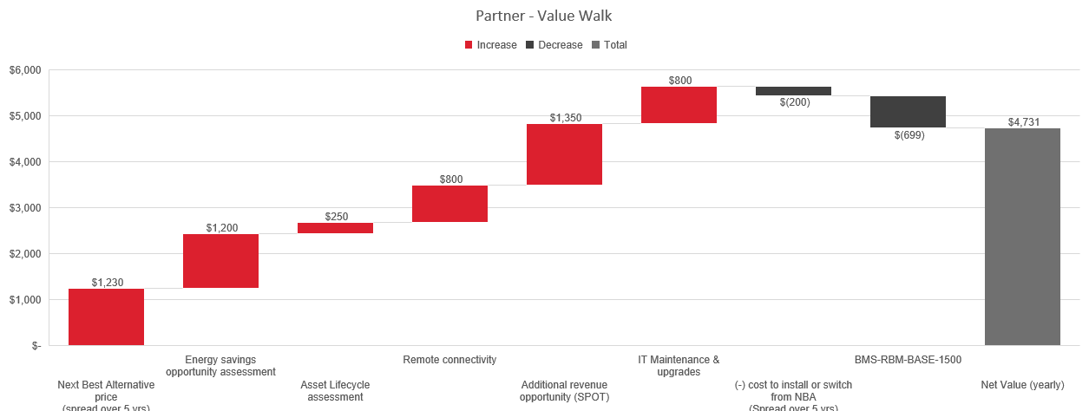
Value proposition & VALUE WALK - partner
REMOTE BUILDING MANAGER

Slide 25
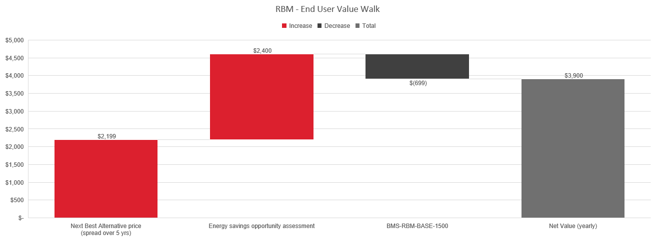
Value proposition & VALUE WALK –
REMOTE BUILDING MANAGER

Slide 26
Target Customer & Target Verticals
TARGET CUSTOMERS
TARGET END-USER VERTICALS
System Integrators looking to leverage technology and differentiate their service offering.
System integrators attempting to augment their labor force with off-site resources and reduce costs.
Progressive Distributors trying to leverage technology to drive business growth
Critical operations (24x7 operational requirements) Verticals - pharmaceutical, hospitality, healthcare.
Premium real estate, campus education
Multi-site retail environments

Slide 27
QUIZ TIME
Honeywell Internal

Slide 28
Thank
You

Slide 29
PARTNER BENEFITS
COST TO SERVE
REVENUE GROWTH
DIFFERENTIATION
Reduce ‘Cost to Serve’ across existing/ new customer site by establishing secure connectivity
Enables remote analysis and fixes, reducing the need for multiple site visits.
Target: 100% remote services
Drive incremental revenue growth through monetization of apps
Growth opportunities for customer identified through obsolescence assessment app
Additional HBOC services
Improved spot sales
Establish offering differentiation by enabling vertical specific applications,
Offering real-time insights and improved services
End to end offering

Slide 30




CUSTOMER BENEFITS
UPTIME
Early identification of issues > faster resolution
Reduction in downtime
Reduction in truck rolls and unplanned expenditure
Easy access to Upgrades
RISK MITIGATION
Identify Obsolete assets early and plan for upgrades to avoid any risks
Avoid Cyber vulnerabilities with latest firmware and software
Elevate Building Performance
ENERGY & SUSTAINABILITY
Monitoring of energy intensive assets
Pre-packaged & flexibility reporting
Optimization for efficient daily operations
.
COMPLIANCE
On demand custom reporting capabilities
Custom dashboards for specific needs
Notes:
UPTIME
Early identification of issues leading to faster resolution
Reduction in downtime
Reduction in truck rolls and unplanned expenditure
Easy access to Upgrades
ENERGY AND SUSTAINABILITY
Sustainability monitoring, reporting and optimization through Forge Sustainability suite of applications

Slide 31
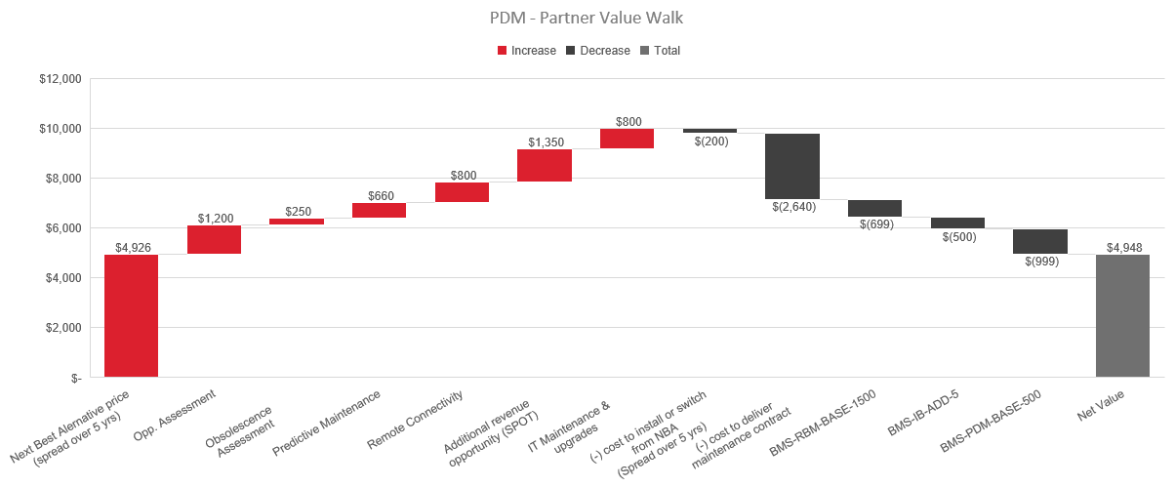
Value proposition & VALUE WALK –
PREDICTIVE MAINTENANCE

Slide 32
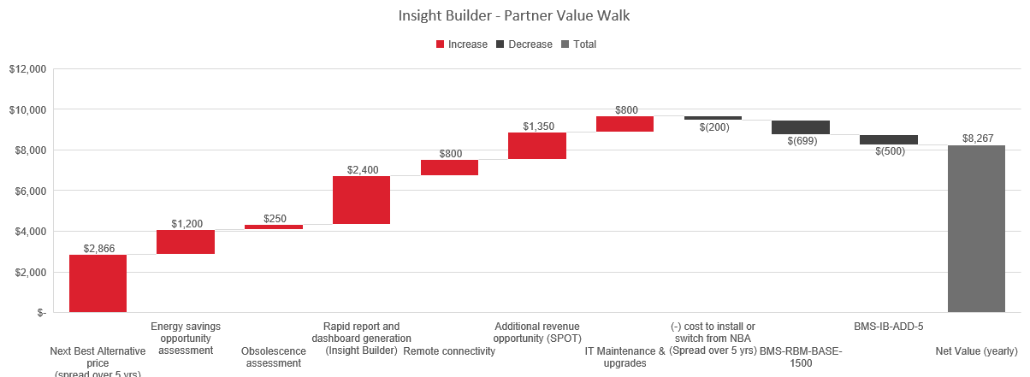
Value proposition & VALUE WALK - partner insight builder

Slide 33
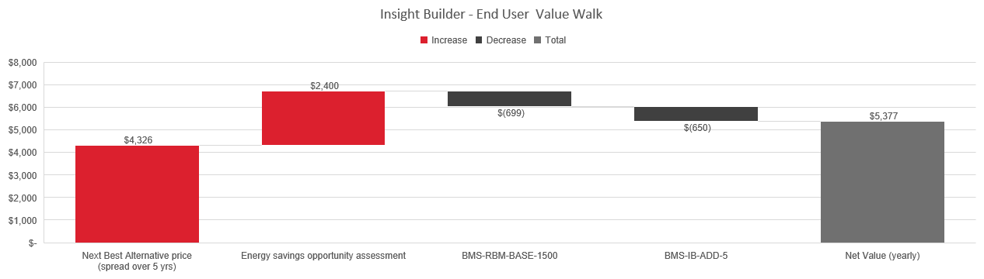
Value proposition & VALUE WALK – end user insight builder
End customer and partner prices seem to be same?

Slide 34
END USER VALUE WALK - CEM MONITOR USE CASE 1
Building Customer
VALUE DRIVERS:
Low Med High
*Building with 3 main meters –CEM monitor, $80 Engineer hourly rate
Value Calculator
Energy Reporting
Energy Consumption Analysis
Cost of NBA
Value of Hon SaaS
Pricing (SaaS)
ROI
NBA Description
A facility resource spending time on manually analyzing monthly utility bills
Prepare carbon emission reports and visualization charts
3
2.5
2
1.5
1
0.5
0
yrs
5
4
3
2
1
0
SAVINGS vs NBA
Energy & Carbon Reporting | $ 960
Utility Bill Analysis & Overview | $ 960
 | $ 1920
($ kUSD)
$1280
$1920
$1280
$1920
Assumptions
1 hour spent per month for meter readings
1 hour spent per month for carbon calculations and preparing reports
2 hours x 12 months x $80/hour = $1920 in labor costs
$599
<1 yrs
Value Price (Maximum Price)
Value Shared with Customer
Target Price
NBA on Prem solution yearly
Value - labor Savings for SI
Value Price (Maximum Price)
ROI

Slide 35


Connected solutions- Overview
DIGITIZATION
MONETIZATION
Partner SI Strategy
End User Strategy
No-BMS Strategy
Connectivity Strategy
Partner Portal
Partner Apps
FORGE APPS
SMB IOT
Multiple Gateways
Disparate Technologies
Few Native Connectors
Separate HBOC Connector
Multiple Admin Portals
No Self Serve
Limited User Management
Poor Subscription Mgmt.
Disparate Platforms
Independent Connectors
Multiple Independent Apps
Limited Domain Specific Apps
No Partner Value Creation Model
Unclear Value
Tedious Deployment
Disparate Products
Poor UX
Outdated Tech
1 Combined Pipe – 3 Form Factor
Remote Management
100% Native Connectors
Combined HBOC Connector
Forge Unified Data Fabric
One Data Lake
Contextualization & Normalization
Integrated Remote Managed
(People + AI) Managed Services
Domain Specific Capability
Merge Maintenance Assist
Outcome Oriented Application
Value Pricing Model
On Demand Delivery
Wireless led - Mobile First
Dimmed Down DIY Deployment
Mobile App Cloud based

Slide 36
Value Proposition: Partners
1
For
System integrators that operate and maintain the BMS infrastructure for portfolios of small to large sized buildings
2
who need
To deliver service contracts with best-in-class service while improving profitability
3
Honeywell’s
HONEYWELL’S Forge for Buildings application suite and HBOC service offering
4
provides $X
30% productivity gain, reducing the cost to serve. Increases revenue growth potential through additional hardware, software and service opportunities
5
unlike
the many disparate offerings that are currently used to create bespoke solutions
6
We do this by
providing a partner portal to readily deploy applications and mange all their customer sites in one location
7
as proven by
Pilot/ Beta sites that are being evaluated with co-creation partners

Slide 37
Value Proposition: Customers
1
For
Customers and End Users
2
who need
best-in-class service and improved asset lifecycle while achieving their strategic goals like operation effectiveness, sustainability, improved uptime.
3
Honeywell’s
HONEYWELL’S Forge for Buildings application suite and HBOC service offering
4
provides $X
xx% energy saving and risk mitigation with improvement in asset uptime and asset lifecycle
5
unlike
the manual processes and the many disparate offerings that are currently used
6
We do this by
connecting sites easily to Forge to provide maximum remote services like Predictive Maintenance, Carbon and Energy Management. Along with the option to connect to HBOC to provide managed services
7
as proven by
Feedbacks received from existing connected customers.

